Slide 1
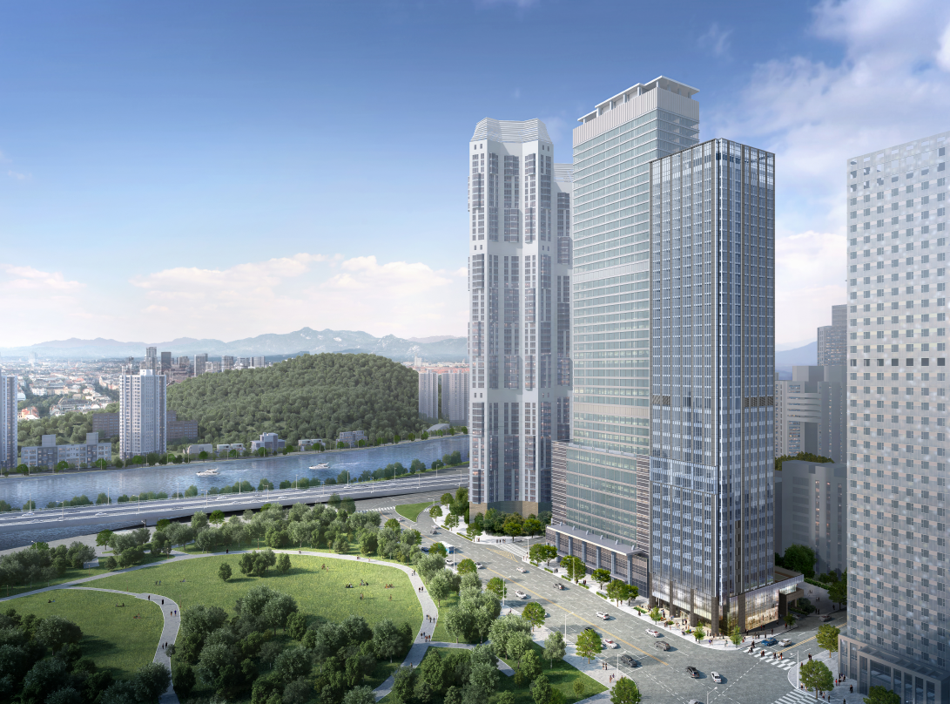
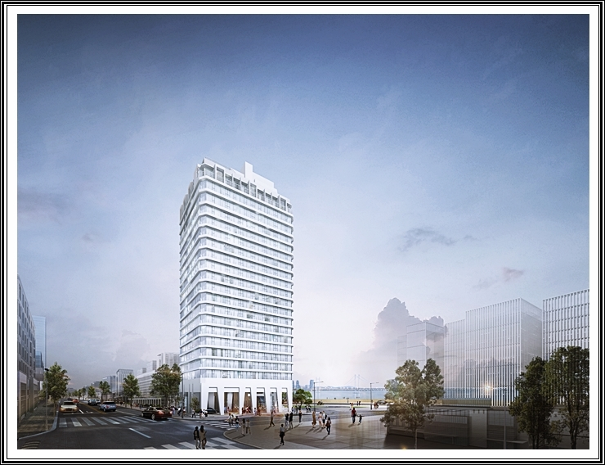
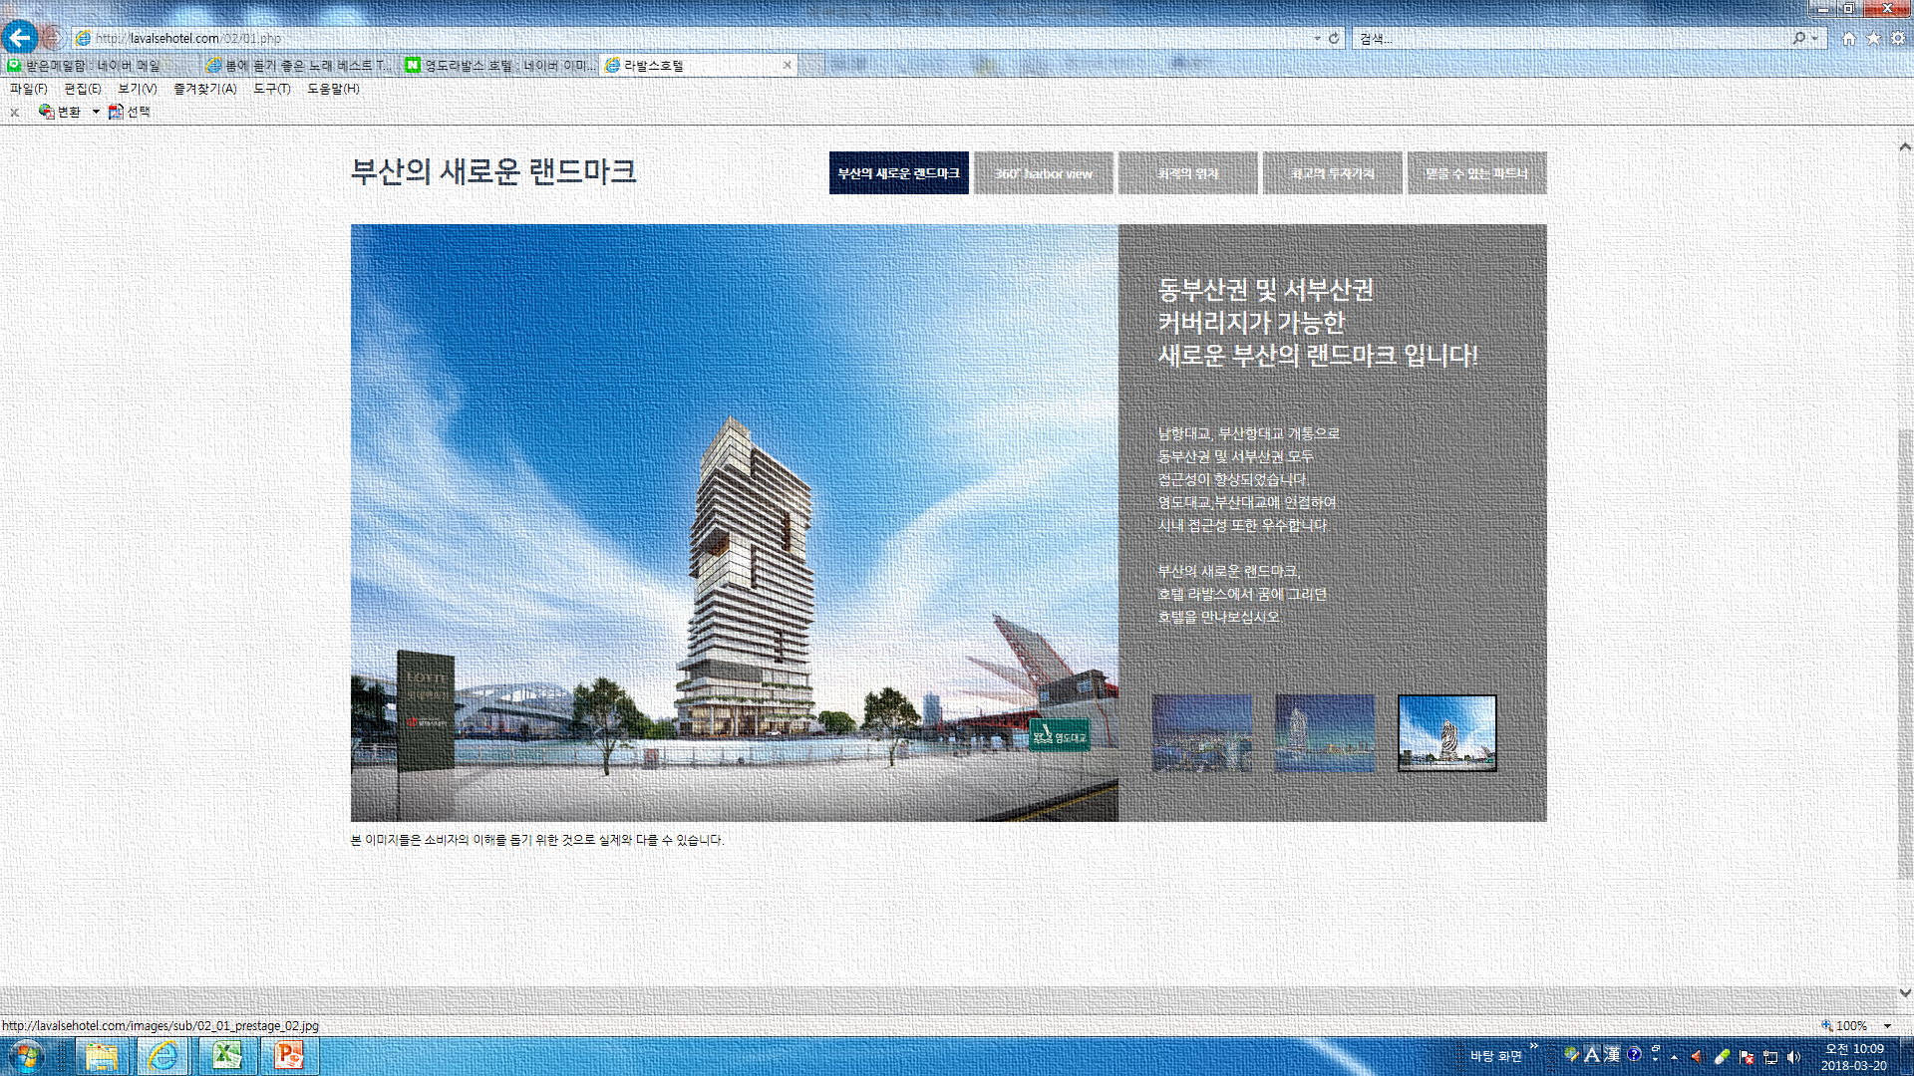
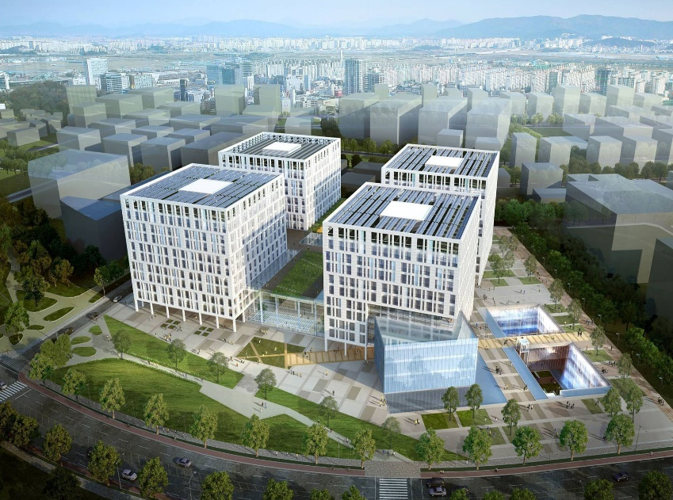

BUYOUNG INDUSTRY
Aluminium windows
Curtain walls
Metal structures
COMPANY PROFILE
Buyoung Industry Co., Ltd.

Slide 2
Dear Valued Customers,
We wish your company continued success.
We wish to participate in the project commissioned by your company and
submit our company profile along with the relevant documents.
We kindly request that you consider our application and nominate us for
this project after your review.
Buyoung Industry Co.,Ltd.
KIM TAE HEE

Slide 3
Contents
1. CEO Greetings
2. Company About
Company Profile
Company Organization
Company History
3. Certifications & Resistrations
Certificate of Business Registration
Certification of International Contractor
Plant Registration Certification
Certificate of ISO 45001
Certificate of ISO 9001
Certificate of Korea Eco-Label
Certificate of Inno-Biz
Certificate of Patent
Certificate of Design Registration
Certificate of Venture Enterprise
4. Credit Rating & Tax Payment
Certificate of Corporate Credit Rating
Certificate of Tax Payment
5. Construction Performance
6. Location

Slide 4
CEO Greetings
Since its establishment in August 2017 as a company specializing in the manufacture and construction of metal structures and windows,
Buyoung Industry has always listened to its customers and carried out
projects with passion and dedication.
At Buyoung Industry, we strive to deliver the highest quality to our
customers across various types of buildings, including houses, hotels, commercial facilities, and officetels.
We will continue to do our best to fulfill our commitment to excellence.
Thank you.
Buyoung Industry Co.,Ltd.
KIM TAE HEE

Slide 5
Company About
Company Profile
Name of Business
Name of Representitive
Date of Business Start
Business Type
Business Address
Buyoung Industry Co.,Ltd.
KIM TAE HEE
2017. 08. 08
Construction, Manufacturing
#1407, 60, Centum buk-daero, Haeundae-gu, Busan, Republic of Korea
Organization
Construction
& Design
CEO
Quality
Management
HR &
Financing
Production
Management
Cost
Management

Slide 6
Company History
2017
2019
2020
2021
2022
2023
2024
2025
2026
08 Established Buyoung Industry Co., Ltd.
09 Obtained a specialized construction license for
metal structure and window construction business
09 Established an R&D department
11 Registered the green remodeling business
01 Registered as a venture enterprise
11 Certified direct production for still windows
12 Designated as Community Regeneration Corporation
03 Registered design for windows
09 Patent for curtain walls with improved insulation and
fire performance
12 Obtained KOSHA-MS certification (ISO45001:2018)
02 Registered products with Public Procurement Service
(insulated curtain walls, window bug screens,
gallery windows, double-insulated sliding windows)
03 Registered Certification of International Contractor
12 Certified direct production for metal fences
07 Obtained quality management system certification
(ISO 9001:2015)
09 Certified for Inno-Biz
01 Registered design for Curtainwall Frame
09 Obtained a specialized construction license for
Structural demolition and scaffolding business
04 Patent for Curtain wall look assembly

Slide 7
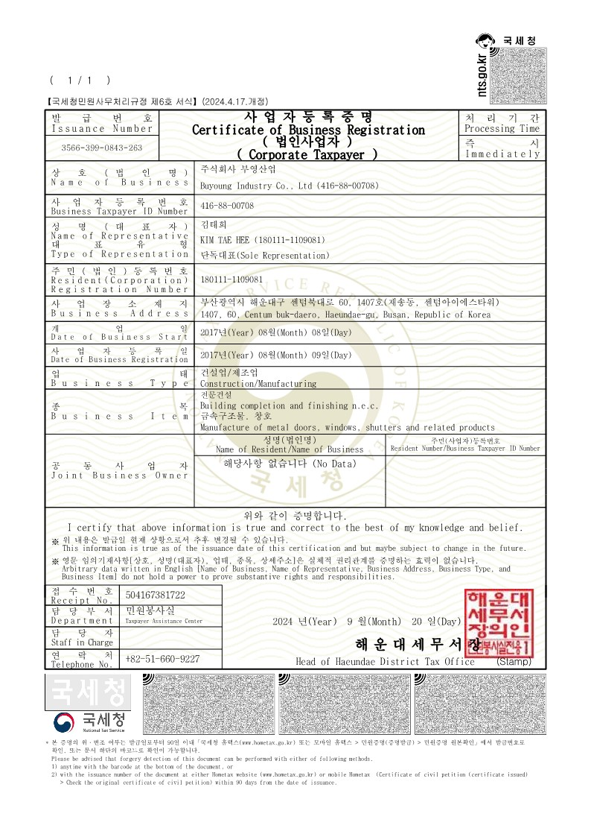
Certifications & Registrations
Certificate of Business Registration┃ KOREA

Slide 8
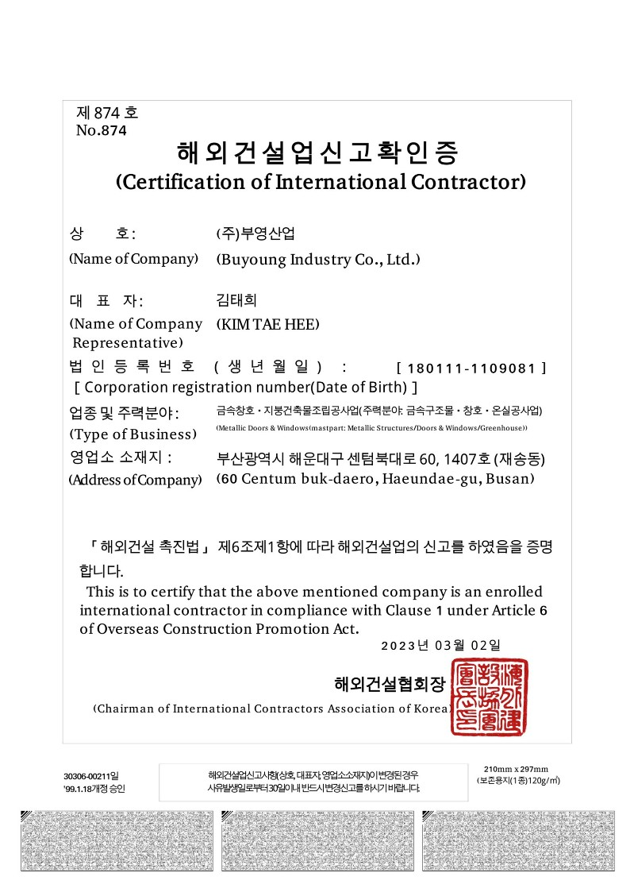
Certification of International Contractor

Slide 9
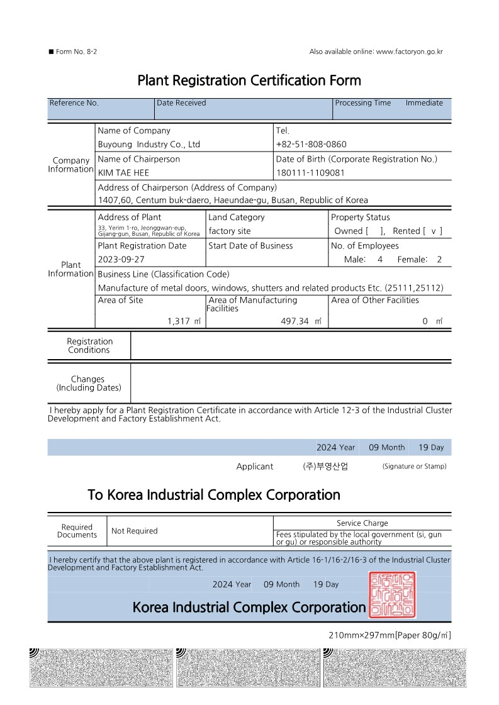
Plant Registration Certification

Slide 10
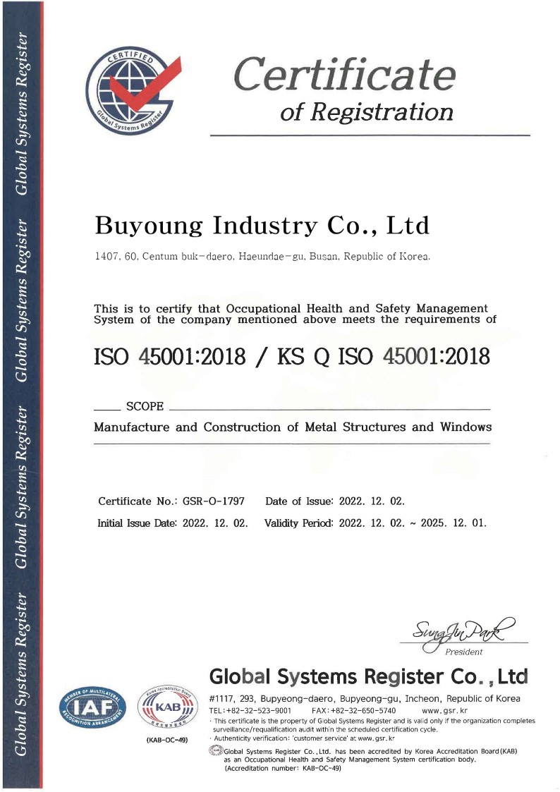
Certificate of ISO 45001

Slide 11
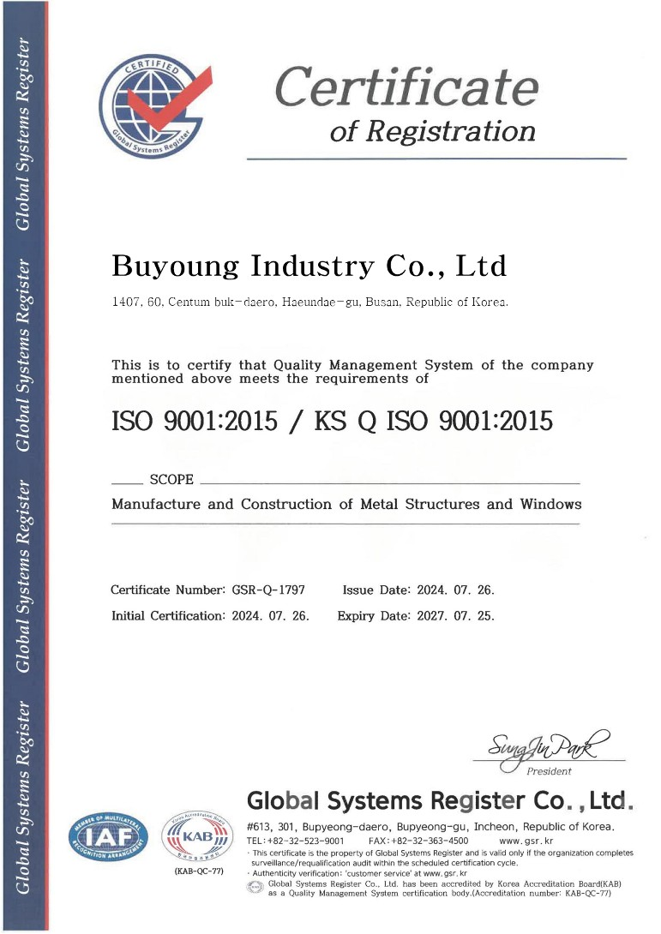
Certificate of ISO 9001

Slide 12
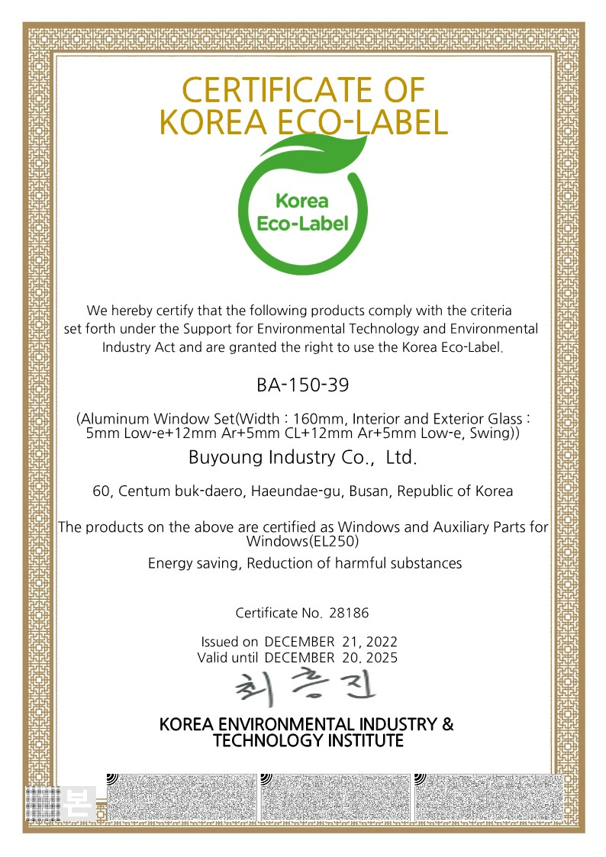
Certificate of Korea Eco-Label ┃ BA-150-39

Slide 13

Certificate of Korea Eco-Label ┃ BA-SL235-24

Slide 14
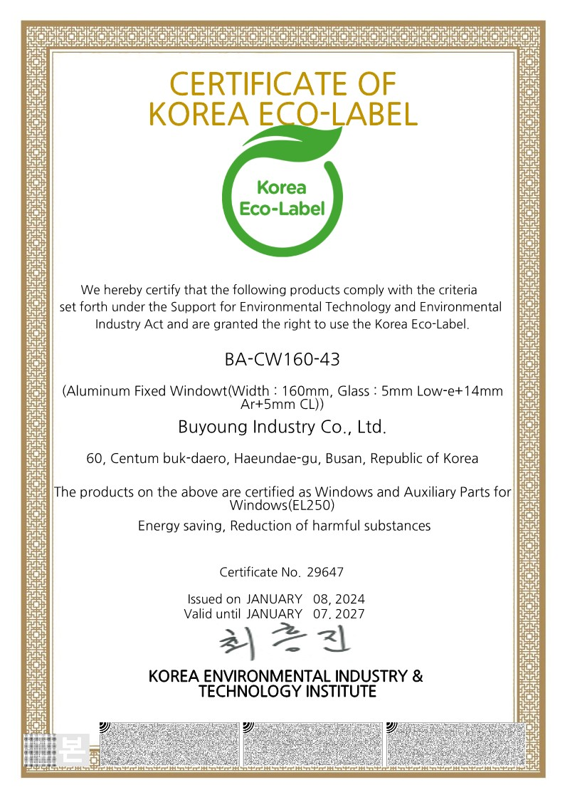
Certificate of Korea Eco-Label ┃ BA-CW160-43

Slide 15
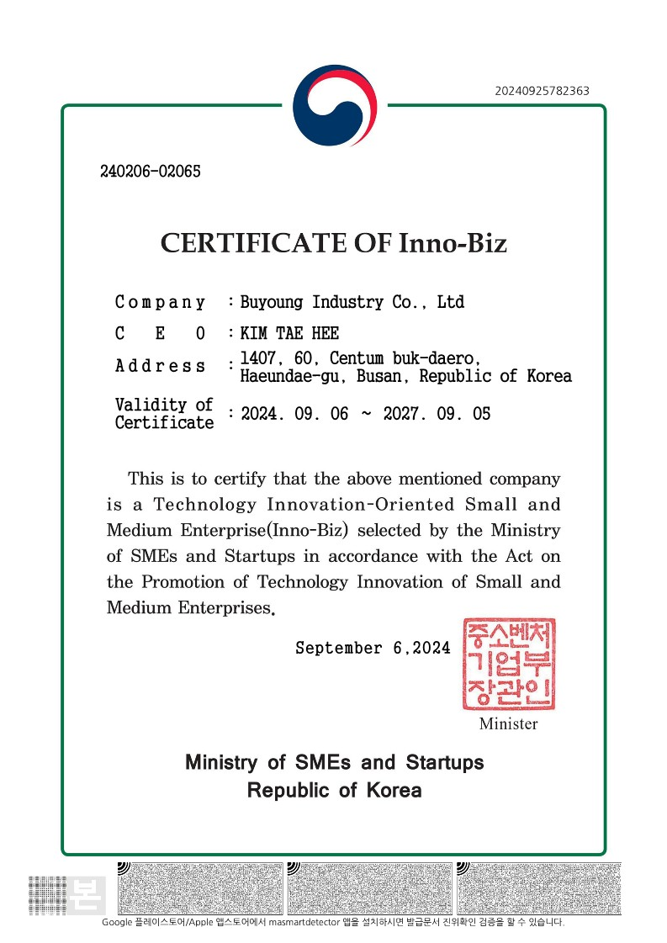
Certificate of Inno-Biz

Slide 16
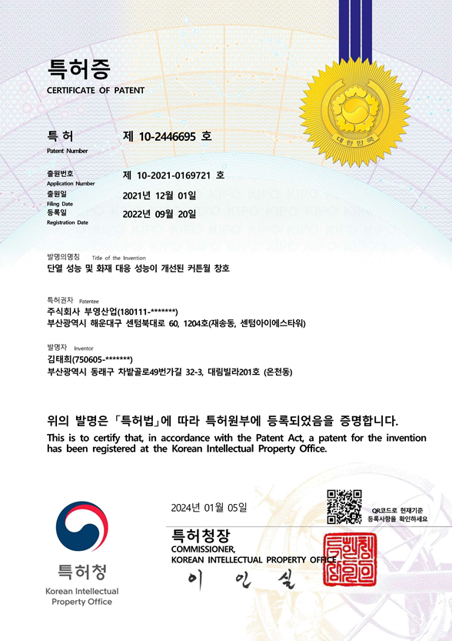
Certificate of Patent
Curtain walls with improved insulation and fire performance

Slide 17
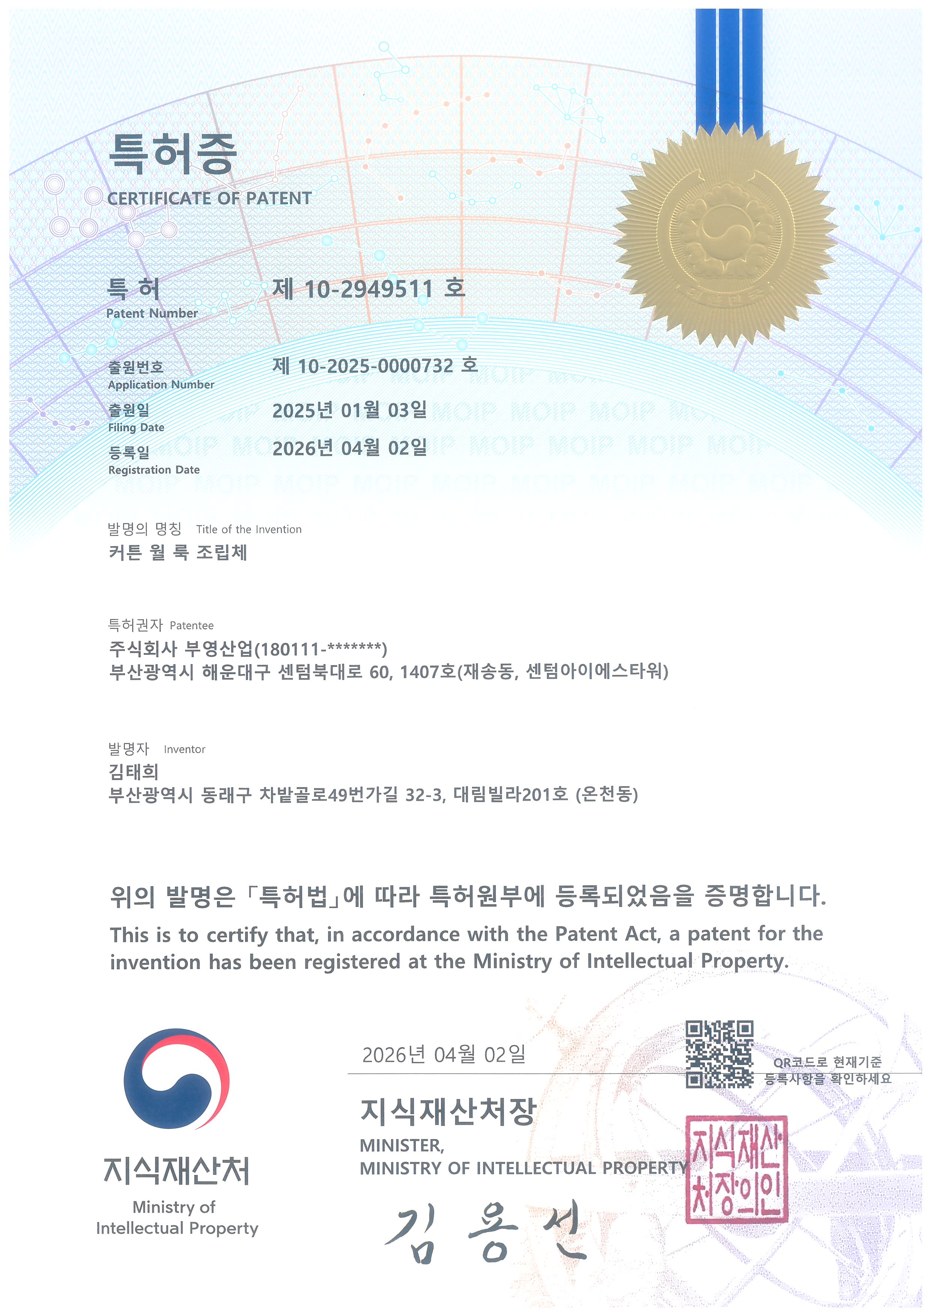
Certificate of Patent
Curtain wall look assembly

Slide 18
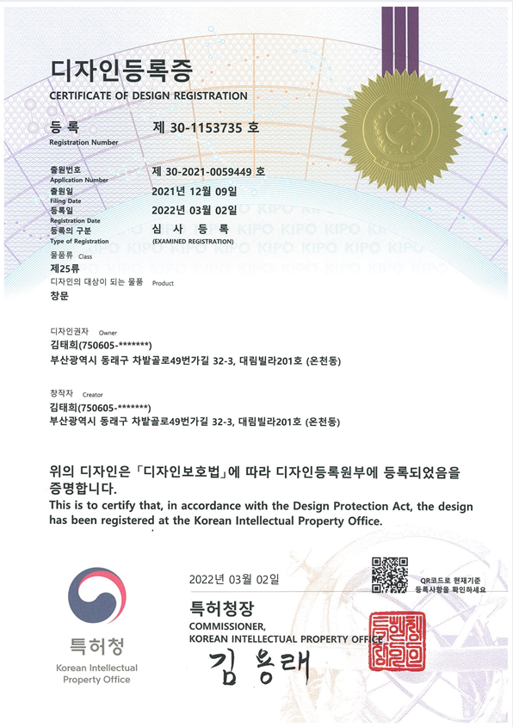
Certificate of Design Registration
Windows

Slide 19
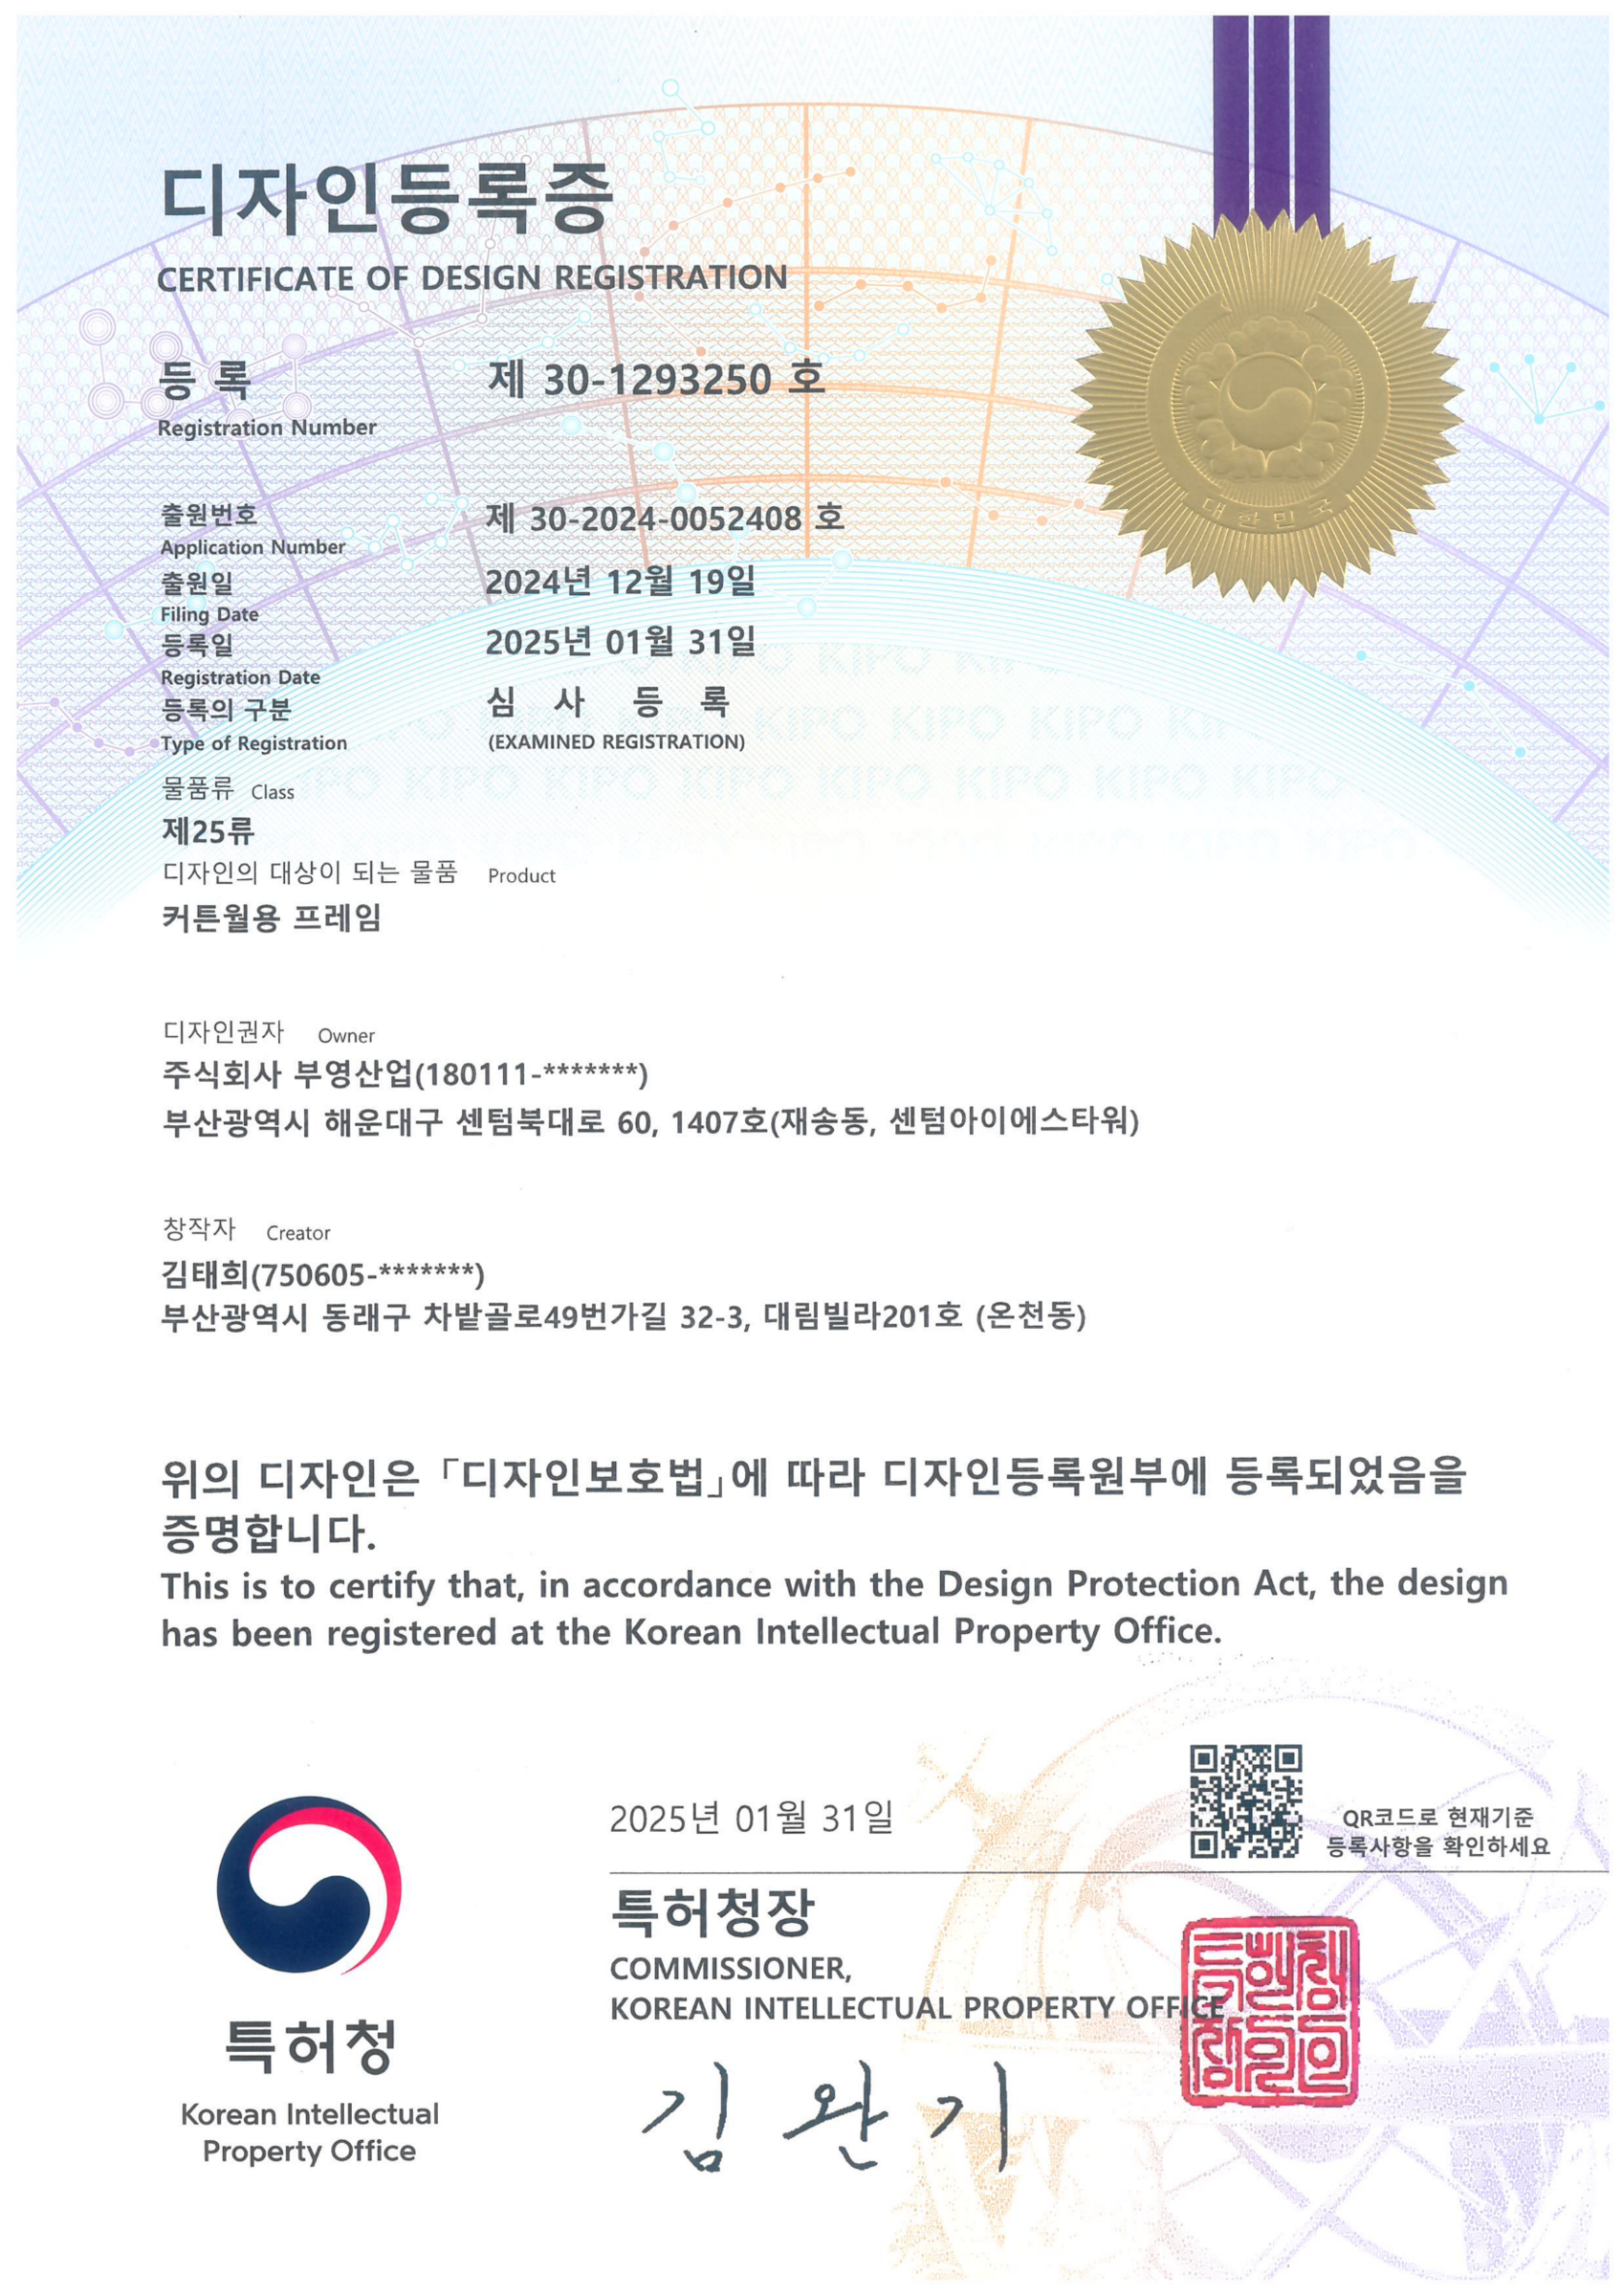
Certificate of Design Registration
Curtainwall Frame

Slide 20
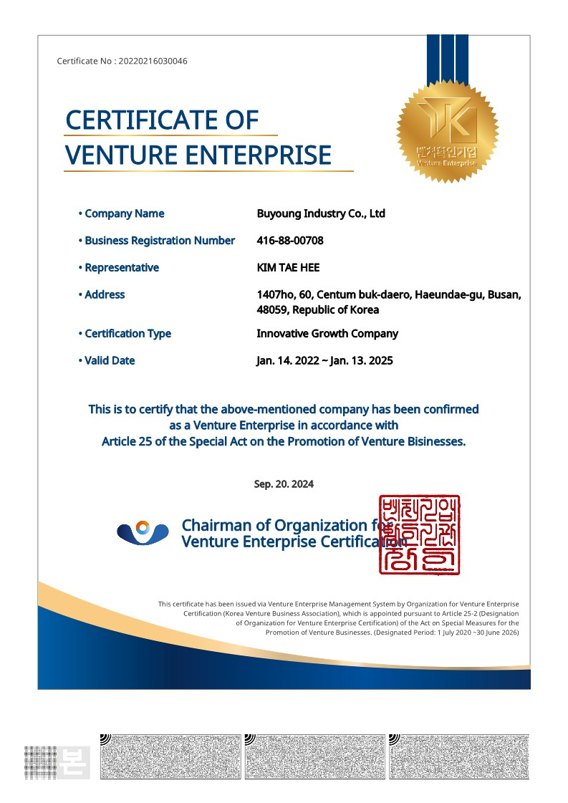
Certificate of Venture Enterprise

Slide 21
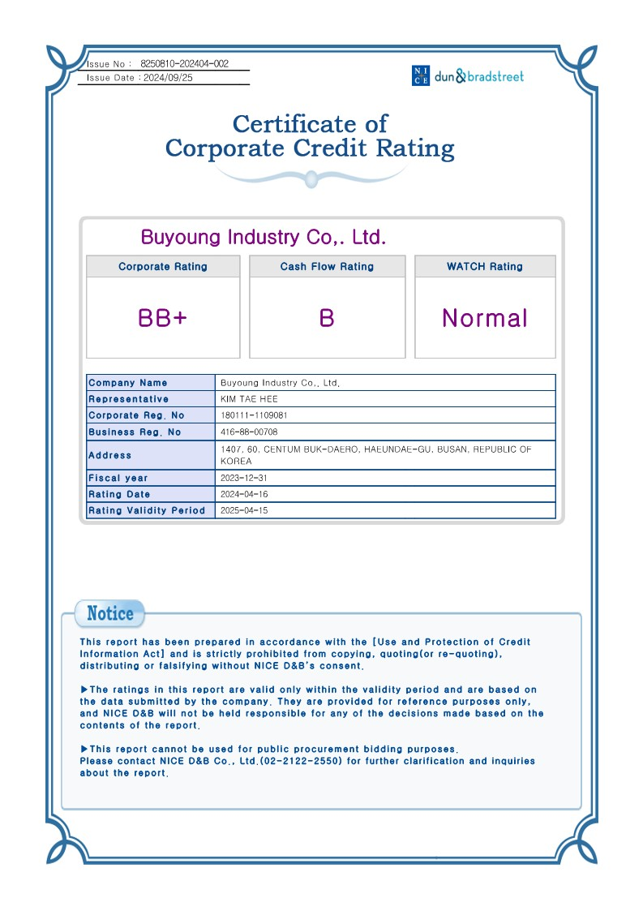
Credit Rating & Tax Payment
Certificate of Corporate Credit Rating

Slide 22
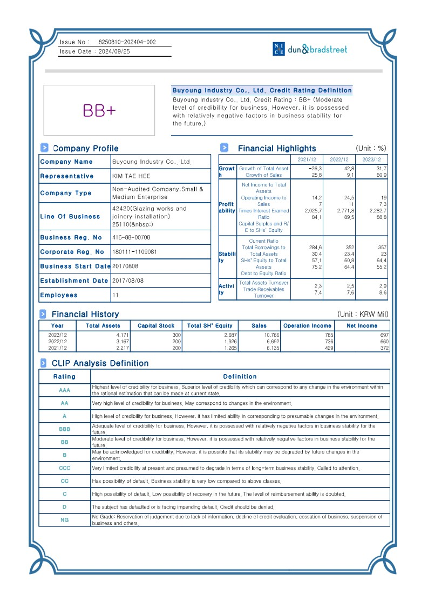
Certificate of Corporate Credit Rating

Slide 23
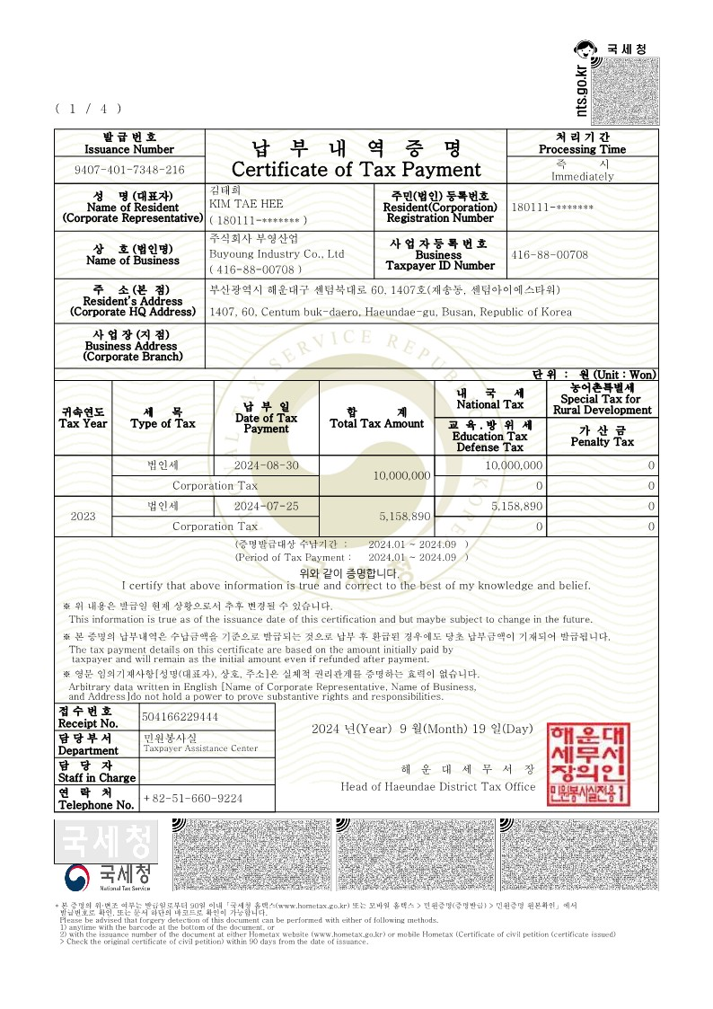
Certificate of Tax Payment

Slide 24

Certificate of Tax Payment

Slide 25
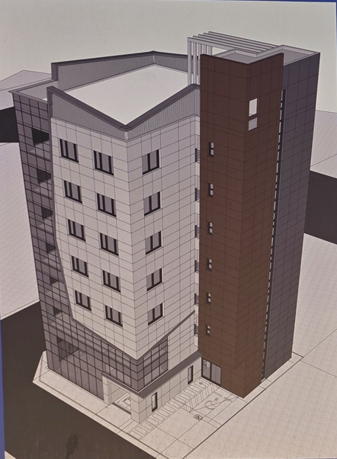
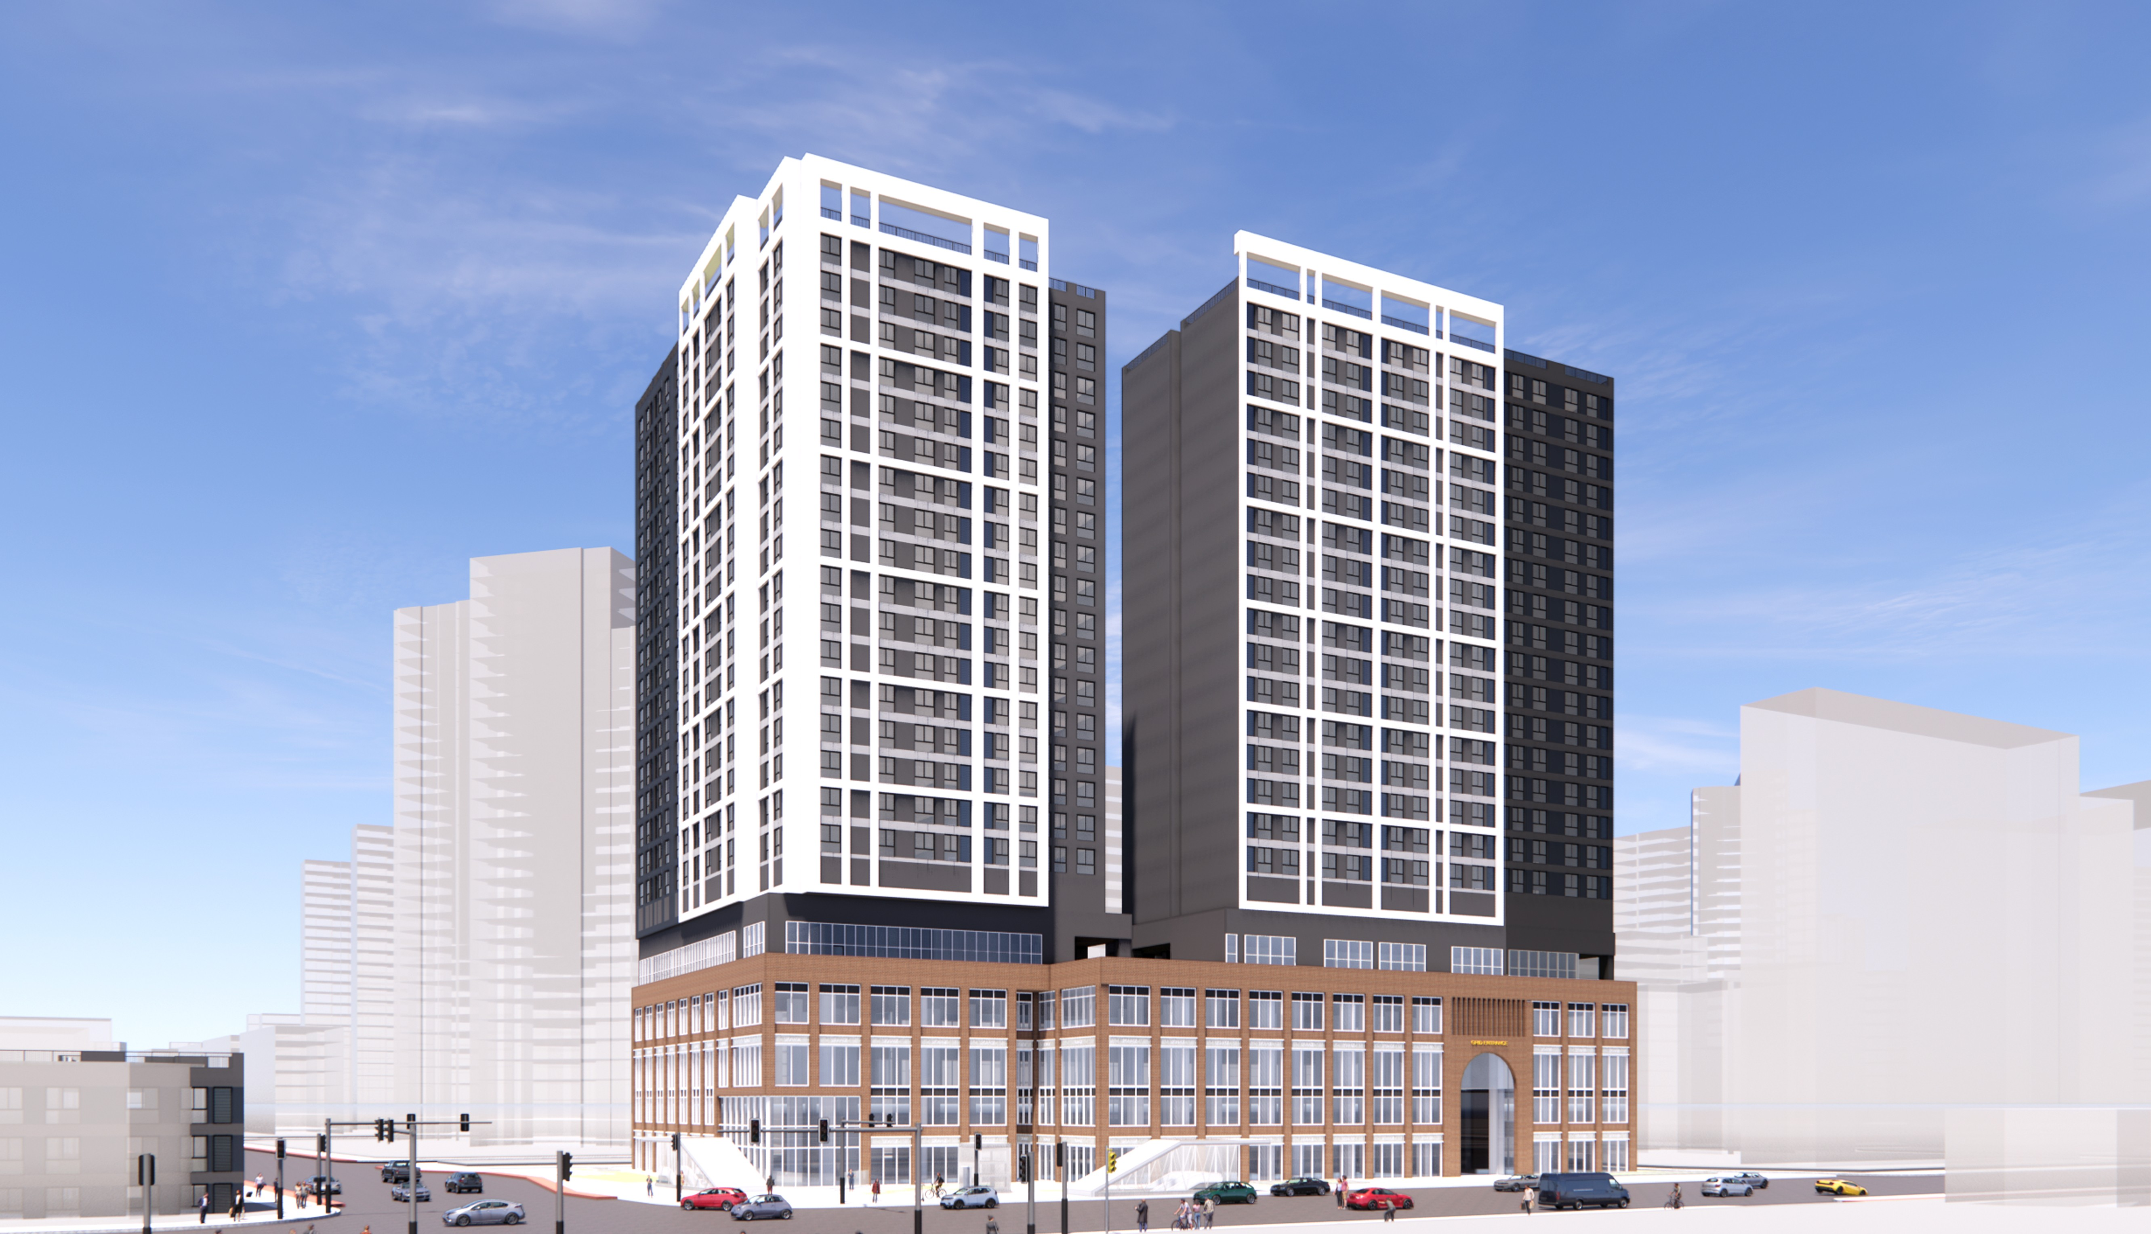
Construction Performance
Project | Metal work and aluminum window for commercial facility in Seongsu-dong 2-ga
Contractor | CHN Construction
Duration | May. 2026 ~ Jul. 2026
Location | 315-2, Seongsu-dong 2-ga, Seongdong-gu, Seoul
Project | Aluminum window for rental housing in Jangwi-dong
Contractor | Hwaseong E&C
Duration | May. 2026 ~ Sep. 2028
Location | 63-112, Jangwi-dong, Seongbuk-gu, Seoul

Slide 26
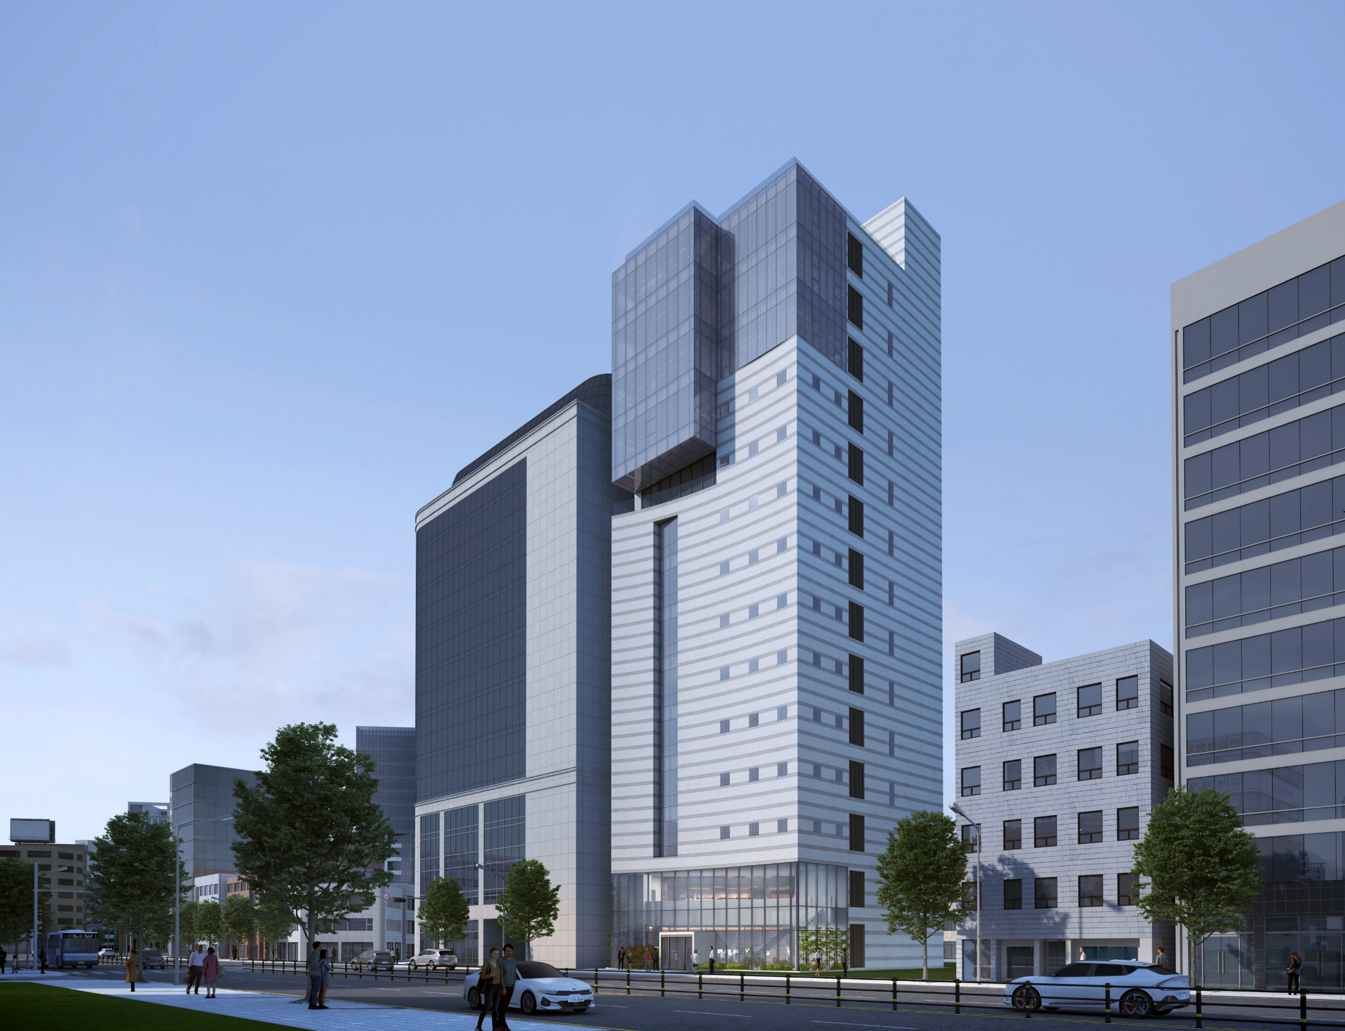
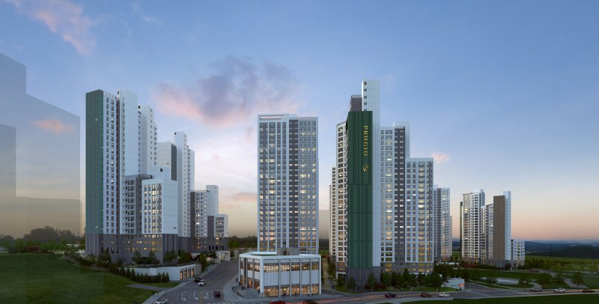
Construction Performance
Project | Window and glass work for commercial facility in Bujeon-dong
Contractor | Heungwoo Constructin
Duration | May. 2026 ~ Mar. 2027
Location | 397-44, Bujeon-dong, Busanjin-gu, Busan
Project | Apartment in Wonju Prugio the central
Contractor | Daewoo Construction
Duration | Mar. 2026 ~ Nov. 2027
Location | 19-8, Namsan-ro 48beon-gil, Wonju-si, Gangwon-do

Slide 27
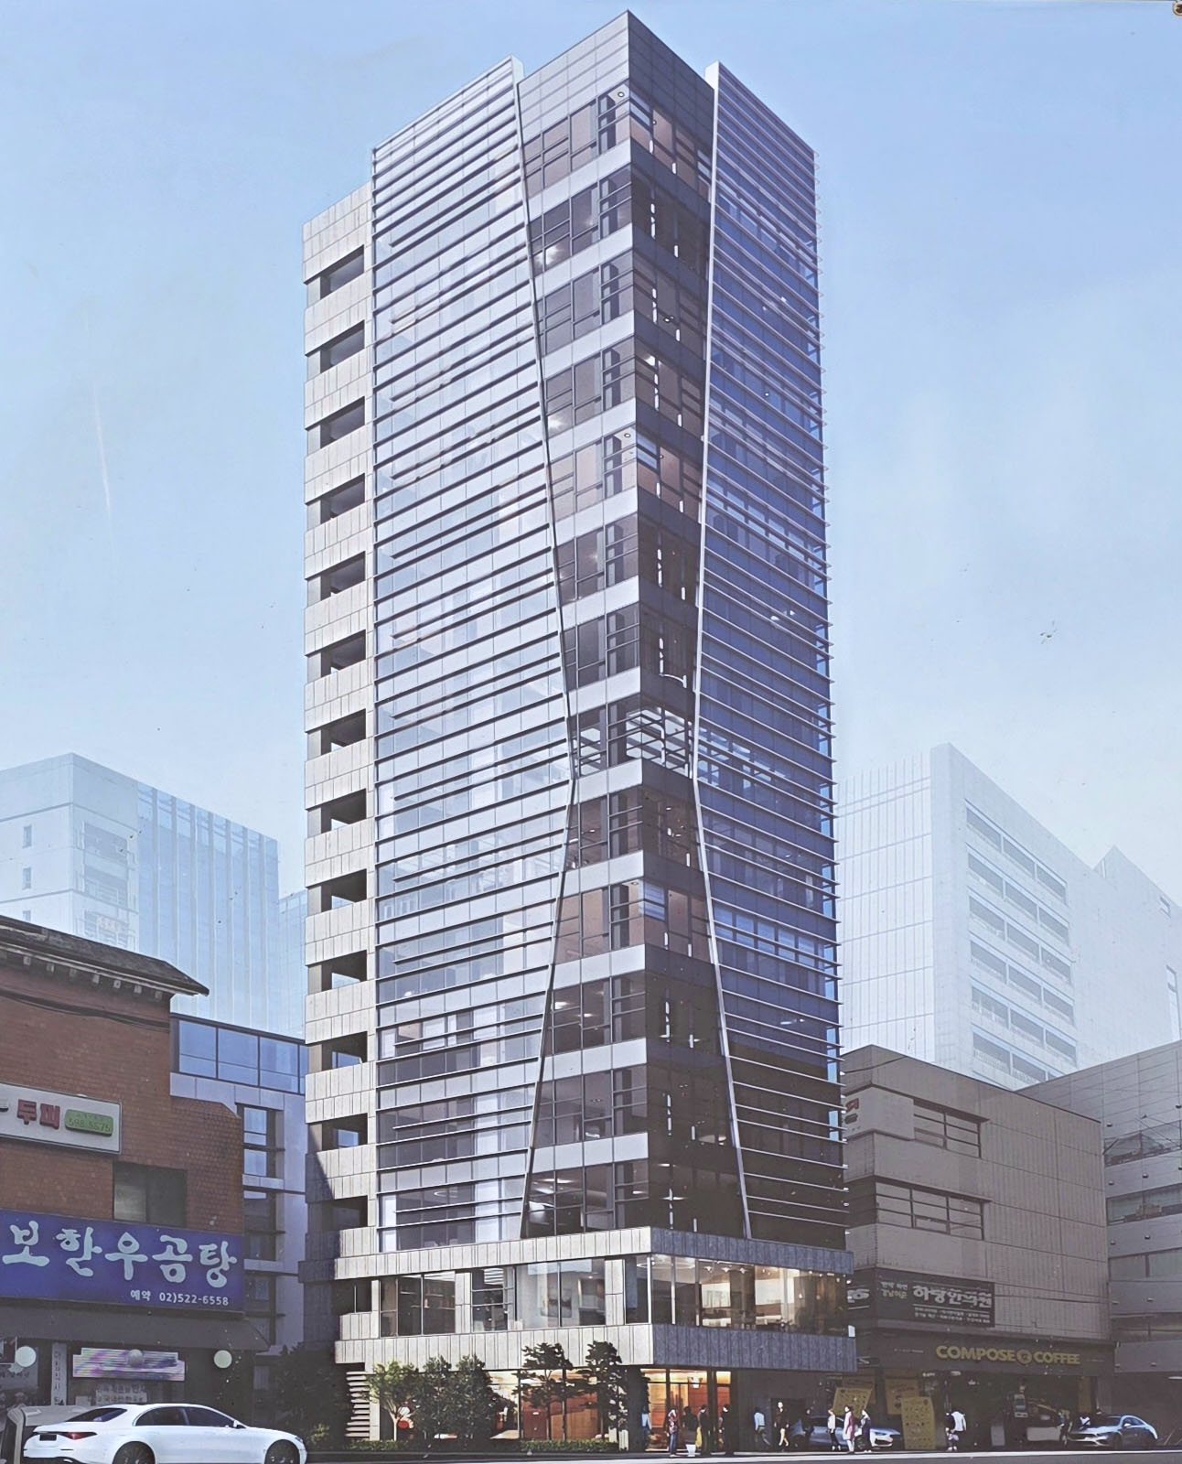
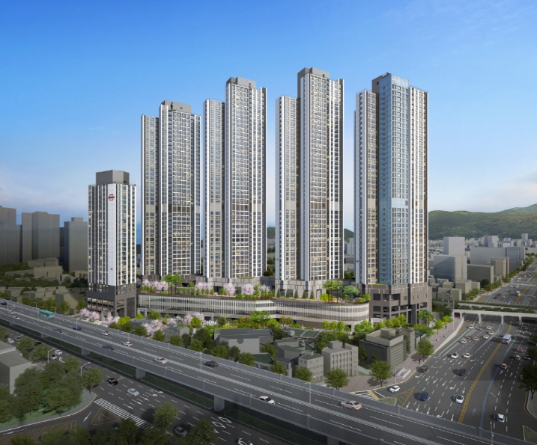
Construction Performance
Project | Metal work and aluminum window for business facility in Seocho-dong
Contractor | CHN Construction
Duration | Mar. 2026. ~ Sep. 2026
Location | 1657-9, Seocho-dong, Seocho-gu, Seoul
Project | Aluminum window and Curtain wall look in Busan Medical County
Contractor | Taeyoung Construction
Duration | Feb. 2026 ~ Jul. 2027
Location | 705-1, Buam-dong, Busanjin-gu, Busan

Slide 28
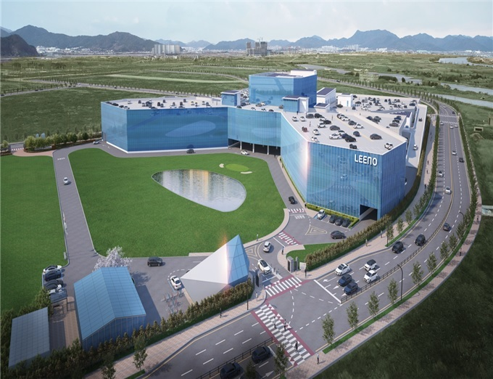
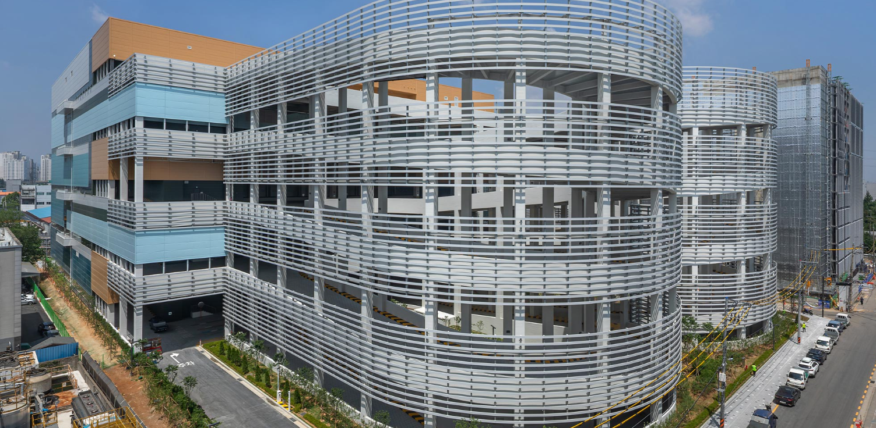
Construction Performance
Project | Metal work in Eco delta City
Contractor | Young-dong
Duration | Aug. 2025 ~ Oct. 2026.
Location | Industrial Block 33, Eco Delta City, Gangseo-gu, Busan
Project | Aluminum window in Bucheon Samjeong-dong Logistics Center
Contractor | CJ Logistics
Duration | Jun. 2025 ~ Apr. 2026
Location | 15-6 Samjeong-dong, Ojeong-gu, Bucheon-si, Gyeonggi-do

Slide 29
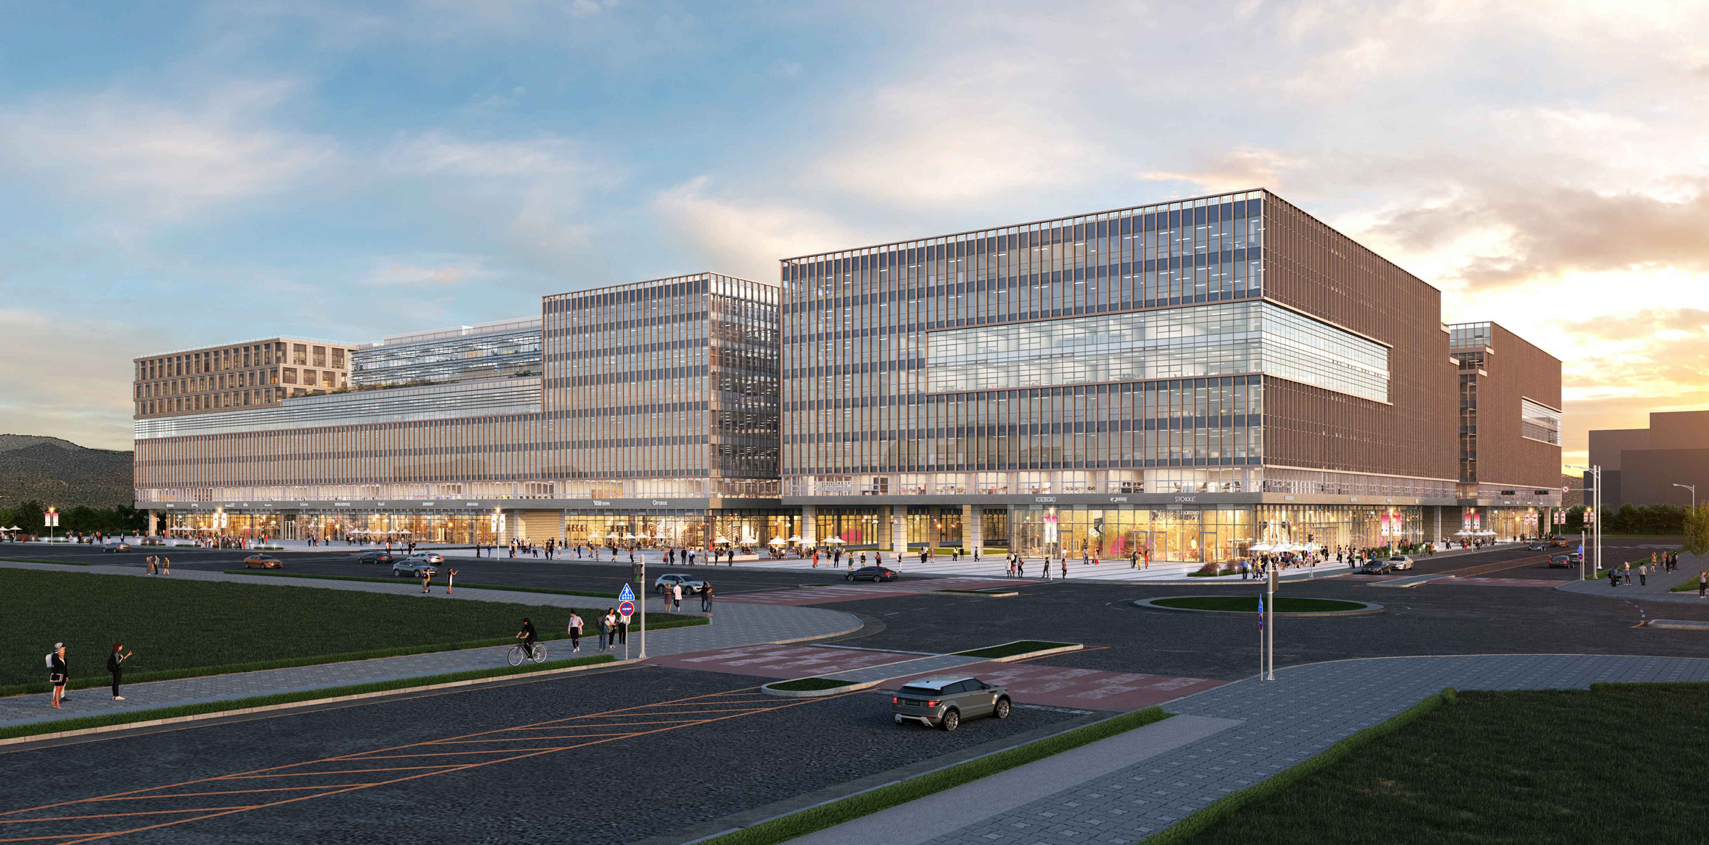
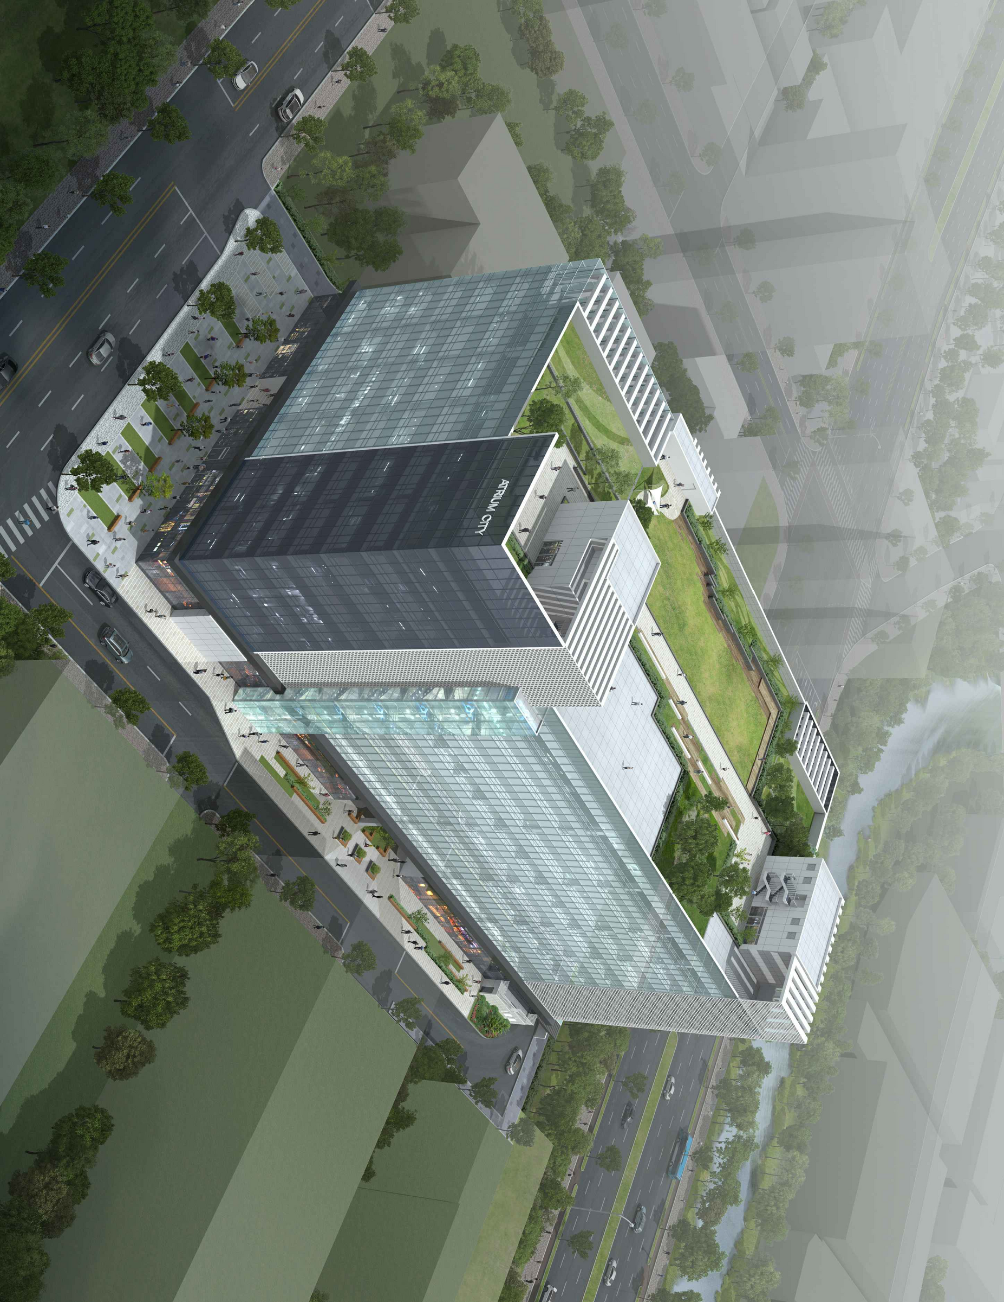
Construction Performance
Project | Curtain wall work for Echo-delta City in Busan
Contractor | Bando Construction
Duration | May. 2025 ~ Aug. 2026
Location | 5 Block in Echo-delta City in Kangseo-gu, Busan
Project | Curtain wall work for Chang-won Artrium City
Contractor | Jiwon Construction
Duration | Apr. 2025 ~ Oct. 2025
Location | 40-13, Palyoung-dong, Changwon-si

Slide 30
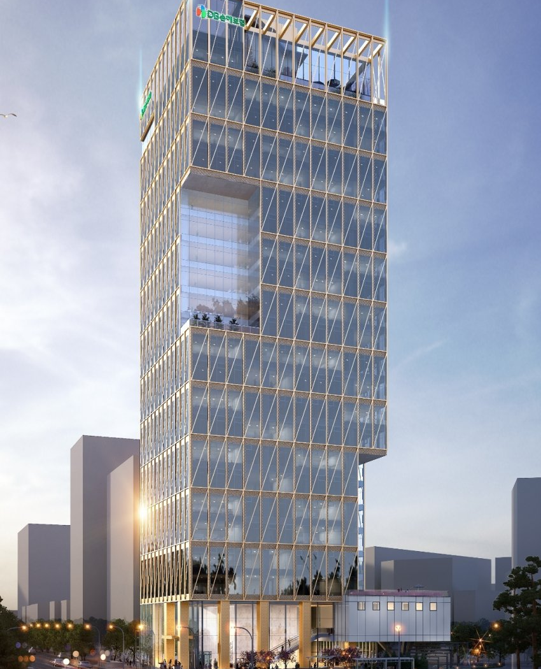
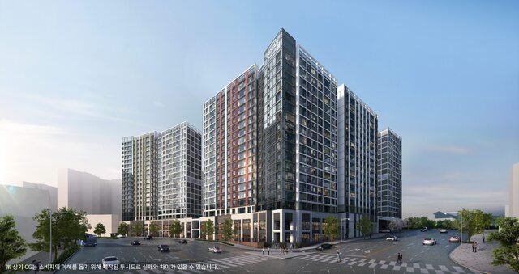
Construction Performance
Project | Curtain wall work for DB Insurance in Busan
Contractor | Taeyoung E&C
Duration | Jan. 2025 ~ May. 2026
Location | 134, Bujen-dong, Busanjin-gu, Busan
Project | Aluminum window installation for apartment in Sinchon-dong, Daegu
Contractor | Taeyoung E&C
Duration | Dec. 2024 ~ Aug. 2025
Location | 481-1, Sinchon-dong, Dong-gu, Daegu

Slide 31
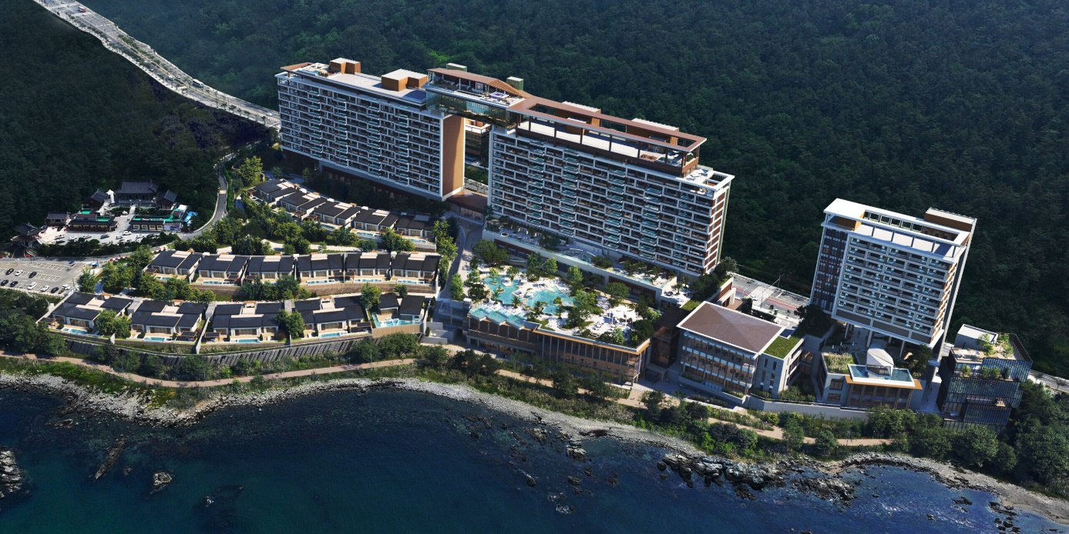
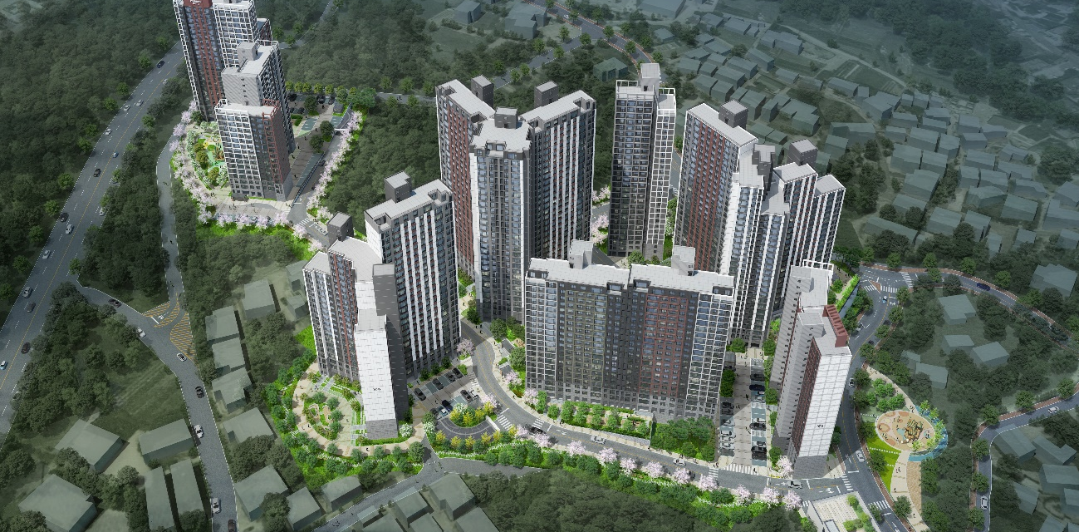
Construction Performance
Project | Curtain wall work for Condominium in Osiria Tourism Complex
Contractor | Samjung Enterprise
Duration | Jun. 2024 ~ Nov. 2024
Location | Na Block 8 lot in Osiria Tourism Complex in Gijang-eup, Gijang-gun, Busan
Project | Apartment in Ayajin-ri, Toseong-myeon, Goseong-gun
Contractor | Taeyoung E&C
Duration | Apr. 2024 ~ Dec. 2025
Location | San 21 and 44 lots in Ayajin-ri, Toseong-myeon, Goseong-gun, Gangwon-do

Slide 32
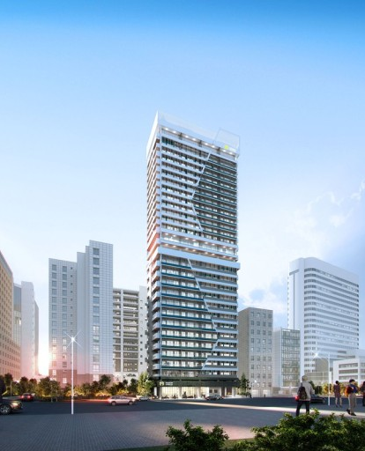
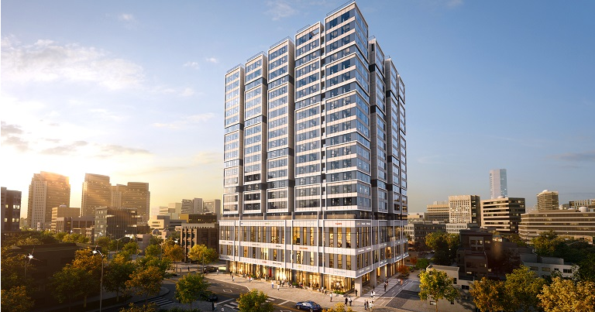
Construction Performance
Project | Fire door, aluminum window and metal work for residence in U-dong, Haeundae-gu
Contractor | Kunjang Construction
Duration | Dec. 2023 ~ Dec. 2024
Location | 648-7 and 2 lots in U-dong, Haeundae-gu, Busan
Project | Aluminum window and curtain wall work for officetel in Seomyeon, Busan
Contractor | Hyosung Heavy Industries
Duration | Dec. 2023 ~ Jan. 2025
Location | 168-291, Bujeon-dong, Busanjin-gu, Busan

Slide 33
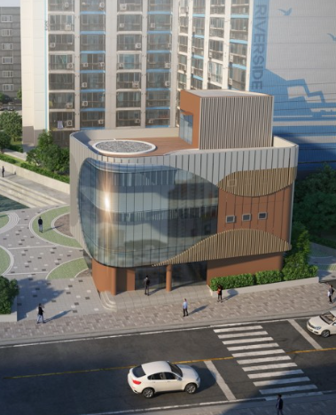
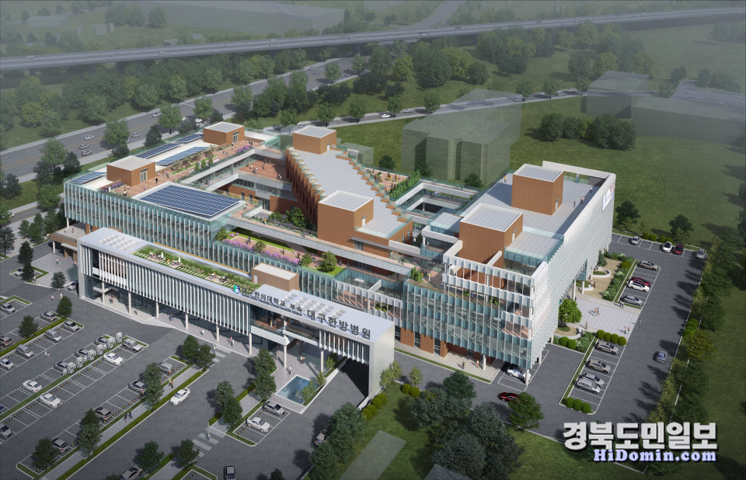
Construction Performance
Project | Metal structure and window installation for Fishing Village New Deal 300 Project in Hadan Port
Contractor | I-jin Construction
Duration | Nov. 2023 ~ Mar. 2024
Location | 1167-3, Hadan-dong, Saha-gu, Busan
Project | Aluminum window installation for Daegu Haany University College of Korean Medicine and Korean Medicine Hospital
Contractor | Taewang E&C
Duration | Dec. 2023 ~ Sep. 2024
Location | 886-3 and 3 lots in Daelim-dong, Dong-gu, Daegu

Slide 34
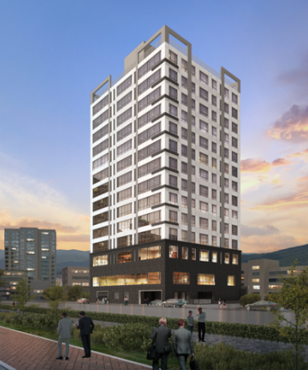
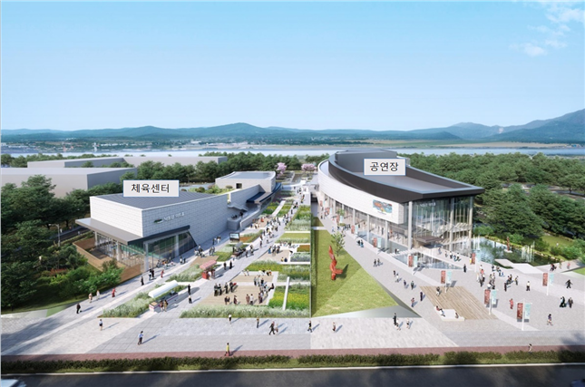
Construction Performance
Project | Window and glass work for officetel in 1098-2, Jaesong-dong, Haeundae-gu
Contractor | Namhung Construction
Duration | Sep. 2023 ~ Jun. 2024
Location | 1098-2, 1098-3, Jaesong-dong, Haeundae-gu, Busan
Project | Window and glass work for Myungji Cultural Complex in Busan
Contractor | Daeyang Industrial Construction
Duration | Sep. 2023 ~ Aug. 2024
Location | 630-8, Myeongji-dong, Gangseo-gu, Busan

Slide 35
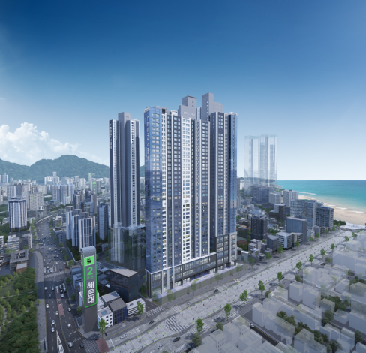
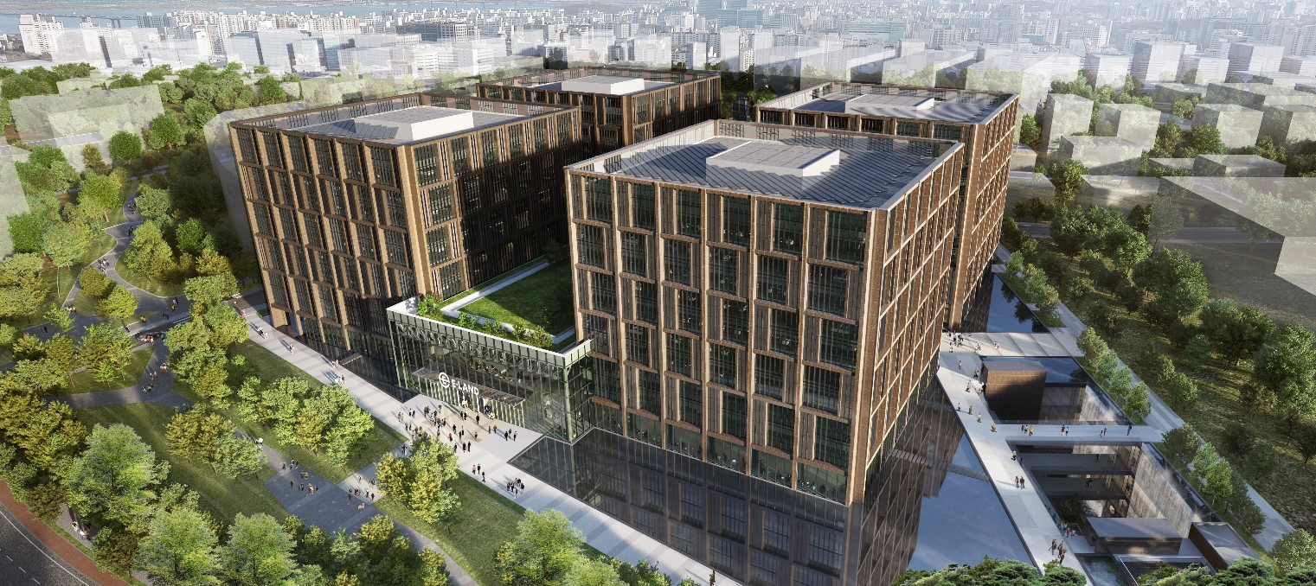
Construction Performance
Project | Curtain wall look work for Haeundae Kyungdong Leein View 2 apartment
Contractor | Kyungdong Construction
Duration | Jul. 2023 ~ May 2024
Location | 548-38, U-dong, Haeundae-gu, Busan
Project | Curtain wall and aluminum window installation for E-Land Global R&D Center in Magok
Contractor | E-Land Construction
Duration | Aug. 2022 ~ Jan. 2024
Location | D16-1,2,4,5,6 Magok Industry Complex in Magok-dong, Gangseo-gu, Seoul

Slide 36
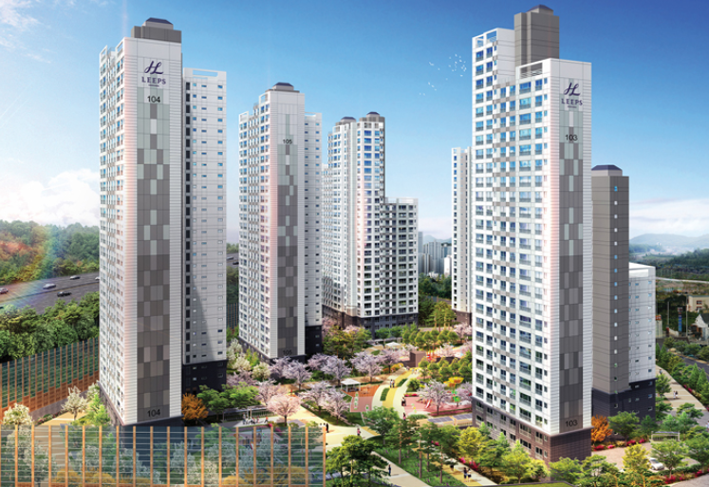
Construction Performance
Project | Metal work for local housing association apartment in Dong-eup, Changwon
Contractor | Hanyang Construction
Duration | Nov. 2022 ~ Dec. 2024
Location | 374-1, Yongjam-ri, Dong-eup, Uichang-gu, Changwon-si, Gyeongsangnam-do
Project | Aluminum window and glass work for residence in Gwangan-dong
Contractor | Heungwoo Construction
Duration | Aug. 2022 ~ Aug. 2023
Location | 199-7, Gwangan-dong, Suyeong-gu, Busan

Slide 37
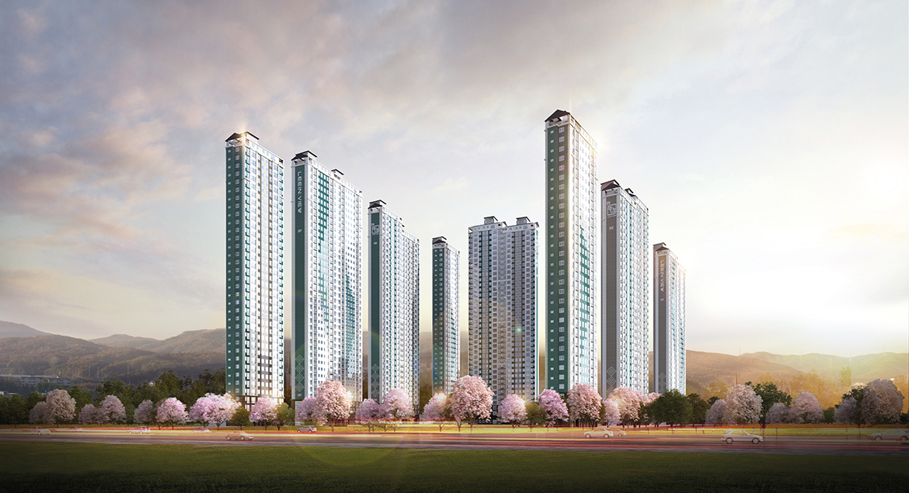
Construction Performance
Project | Steel roof frame work for Daecheongcheon Kyungdong Leein View apartment
Contractor | Kyungdong Construction
Duration | Jan. 2023 ~ Oct. 2023
Location | 1254, Sinmun-dong, Gimhae-si, Gyeongsangnam-do
Project | Aluminium window installation for residence in U-dong, Haeundae
Contractor | Fine Construction
Duration | Jun. 2022 ~ Apr. 2024
Location | 1513, U-dong, Haeundae-gu, Busan

Slide 38
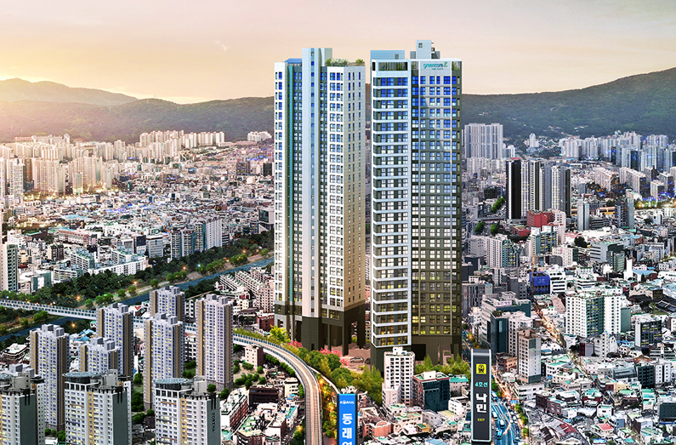
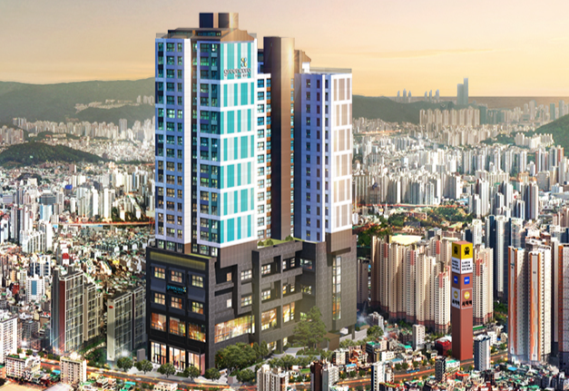
Construction Performance
Project | Metal structure and window installation for Samjung Green Core The City apartment in Nakmin Station
Contractor | Samjung Construction
Duration | Jul. 2022 ~ Jul. 2024
Location | 288-44, Nangmin-dong, Dongnae-gu, Busan
Project | Metal structure and window installation for Asiad Samjung Green Core The City residence
Contractor | Samjung Construction
Duration | Jul. 2022 ~ Jun. 2024
Location | 62-4, Sajik-dong, Dongnae-gu, Busan

Slide 39
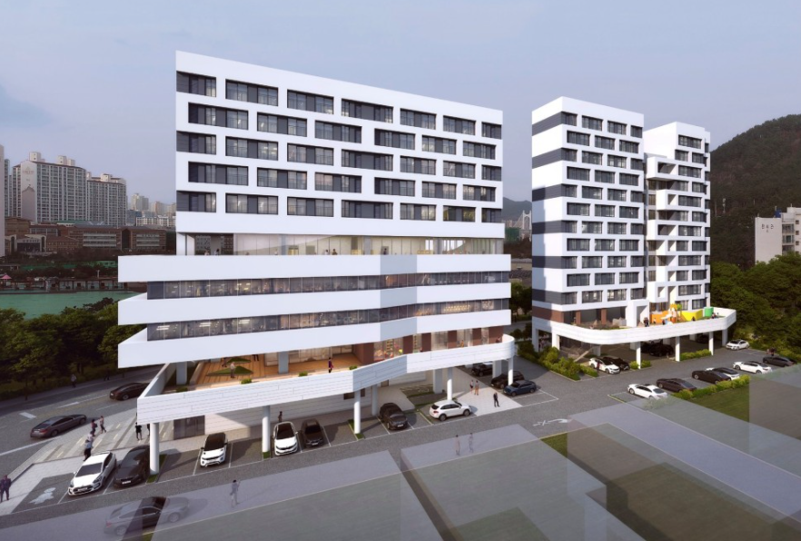
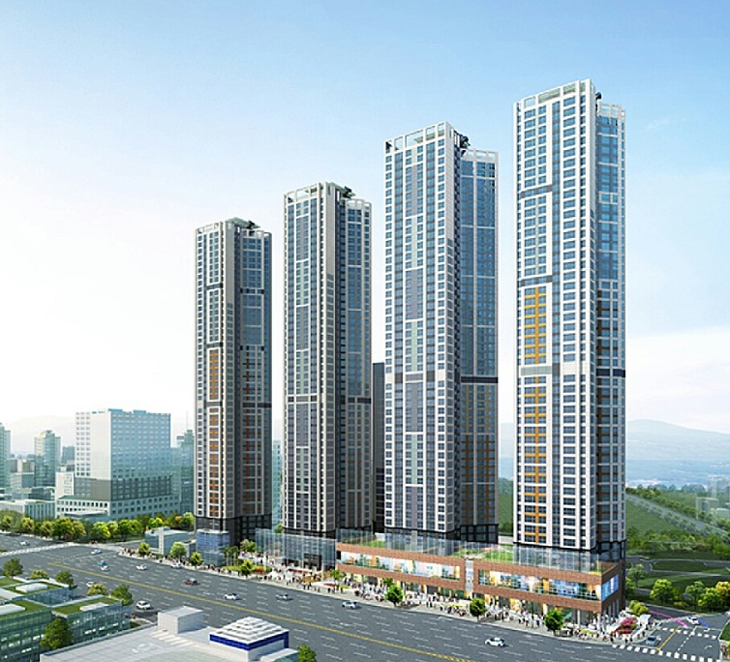
Construction Performance
Project | Metal and aluminium window installation for Happy House on KECO land
Contractor | Kyungdong Construction
Duration | Mar. 2022 ~ Sep. 2022
Location | 23, 87-4 in Yongho-dong, Nam-gu, Busan
Project | Curtain wall look work for ijin Zen City Gaegeum apartment
Contractor | I-jin Construction
Duration | Feb. 2022 ~ Dec. 2022
Location | 187-1, Gaegeum-dong, Busanjin-gu, Busan

Slide 40
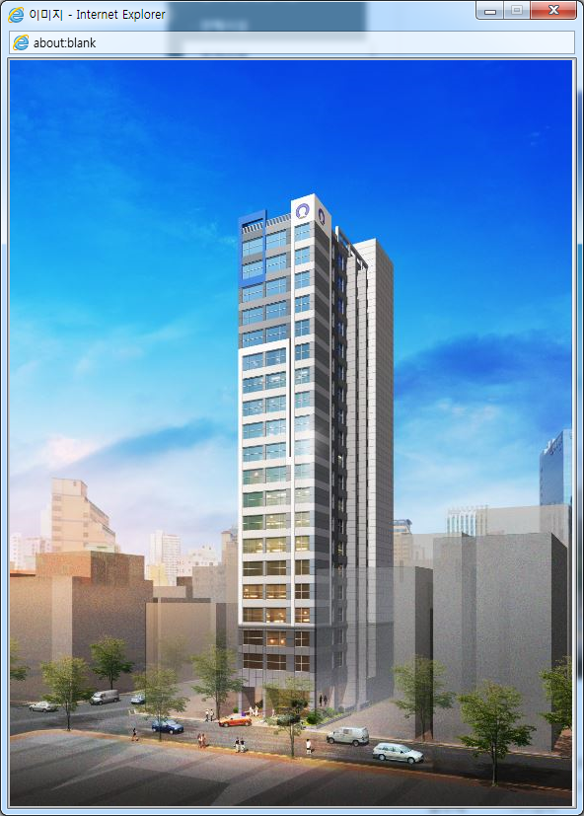
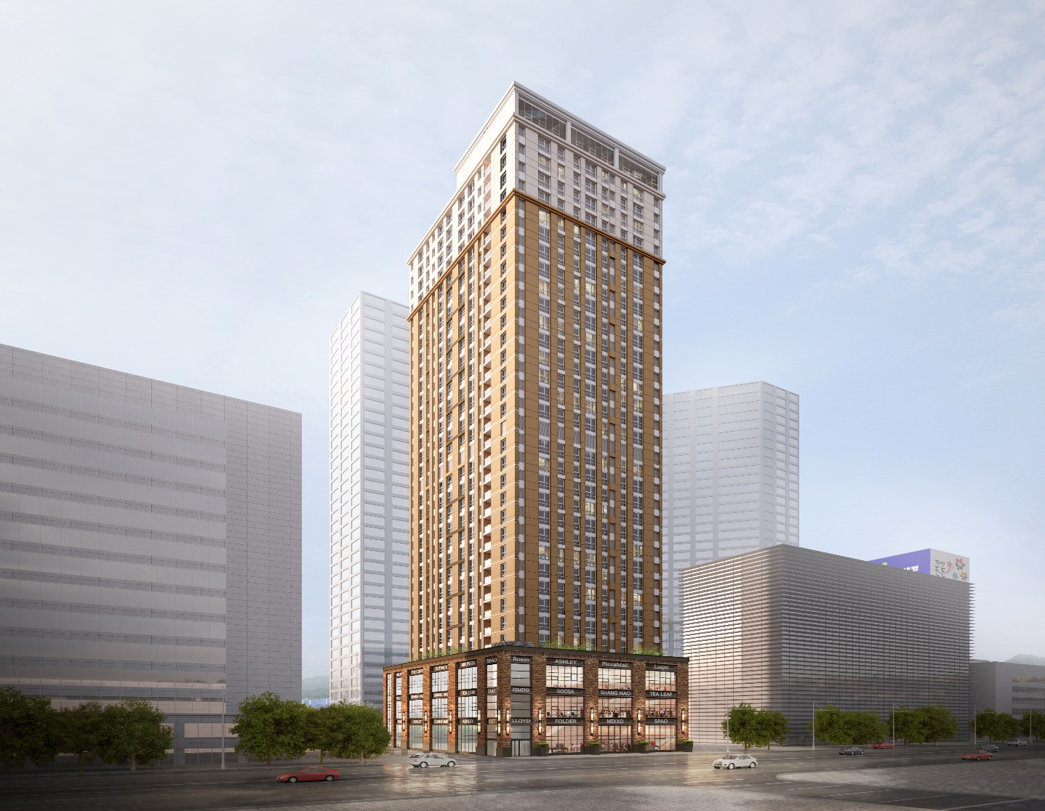
Construction Performance
Project | Aluminum window installation for Sambi residence in Beomcheon-dong
Contractor | Young Dong
Duration | Jan. 2020 ~ Aug. 2020
Location | 869-24, Beomcheon-dong, Busanjin-gu, Busan
Project | Metal and aluminum window installation for Seomyeon Dream Apartment
Contractor | E-Land Construction
Duration | Jun. 2020 ~ Feb. 2022
Location | 536-2,18, Bujeon-dong, Busanjin-gu, Busan

Slide 41


Construction Performance
Project | Metal, window and glass work for Yeongdo Haean officetel
Contractor | Chiseon Construction
Duration | Apr. 2019 ~ Feb. 2020
Location | 47, Daegyo-dong 1-ga, Yeongdo-gu, Busan
Project | Metal, window and glass work for Gaya Nuriae 2 officetel in Beomcheon-dong
Contractor | Gaya Construction
Duration | Feb. 2019 ~ Jun. 2020
Location | 974-16, Beomcheon-dong, Busanjin-gu, Busan

Slide 42


Construction Performance
Project | Aluminum window and glass work for Cheongna Samjung Green Core The City officetel in Incheon
Contractor | Samjung Construction
Duration | Jul. 2021 ~ Apr. 2022
Location | 97-1, Cheongna-dong, Seo-gu, Incheon
Project | Metal window and glass work for apartment in Okgok, Gwangyang
Contractor | Namhung Construction
Duration | Sep. 2021 ~ Aug. 2022
Location | 453, Singeum-ri, Okgok-myeon, Gwangyang-si, Jeollanam-do

Slide 43


Construction Performance
Project | Window and glass work for commercial facility in Dongsam-dong, Yeongdo-gu
Contractor | Heungwoo Construction
Duration | Aug. 2020 ~ Mar. 2021
Location | 201-6, Dongsam-dong, Yeongdo-gu, Busan
Project | Aluminum window and glass work for commercial facility in Sirang-ri
Contractor | Young Dong
Duration | Feb. 2021 ~ Sep. 2021
Location | 615-1 and 3 lots in Sirang-ri, Gijang-eup, Gijang-gun, Busan

Slide 44


Construction Performance
Project | Window and glass work for JM COFFEE & ROASTERS
Contractor | The Jam Korea
Duration | Dec. 2020 ~ Dec. 2021
Location | 265 and 5 lots in Daebyeon-ri, Gijang-eup, Gijang-gun, Busan
Project | Metal structure and window installation for Lavalse Hotel in Yeongdo
Contractor | Daesungmoon
Duration | Feb. 2018 ~ Dec. 2018
Location | 29, Bongnae-dong 1-ga, Yeongdo-gu, Busan

Slide 45


Construction Performance
Project | Metal, window and glass work for Jinyeong (Busan) service station project
Contractor | Namhung Construction
Duration | Jun. 2020 ~ Dec. 2021
Location | 94-4, Hagye-ro 96beon-gil, Jinyeong-eup, Gimhae-si, Gyeongsangnam-do
Project | Metal window installation for Daegu University dormitory (Dorm 11) extension
Contractor | Namhung Construction
Duration | Nov. 2019 ~ Nov. 2020
Location | 201, Daegudae-ro, Jillyang-eup, Gyeongsan-si, Gyeongsangbuk-do

Slide 46


Construction Performance
Project | Metal structure and window installation for S&SYS Busan plant
Contractor | Young Dong
Duration | Jun. 2020 ~ Sep. 2021
Location | 37, Garisae 3-ro, Gangseo-gu, Busan
Project | Metal window installation for Lotte Global Logistics Dongdaegu sub-terminal
Contractor | Namhung Construction
Duration | May 2021 ~ Nov. 2021
Location | 1151, Yuram-dong, Dong-gu, Daegu

Slide 47


Construction Performance
Project | Window and glass work for Coupang logistics center in Yongin
Contractor | Young Dong
Duration | Sep. 2020 ~ Oct. 2020
Location | 487-1, Baekbong-ri, Baegam-myeon, Cheoin-gu, Yongin-si, Gyeonggi-do
Project | Metal structure and window installation for Coupang ANS4 FC extension
Contractor | Young Dong
Duration | Jul. 2020 ~ Oct. 2020
Location | San 118, Jangneung-ri, Juksan-myeon, Anseong-si, Gyeonggi-do

Slide 48


Construction Performance
Project | Window installation for Coupang GHM2 substantial repair in Gimhae
Contractor | Young Dong
Duration | Mar. 2021 ~ Apr. 2021
Location | 5-8, Daegam-ri, Sangdong-myeon, Gimhae-si, Gyeongsangnam-do
Project | Dong-A Electric Osong Biopolis production and research facility construction
Contractor | Changsung Industry
Duration | Dec. 2018 ~ Oct. 2019
Location | 379-5, Jeongjung-ri, Osong-eup, Heungdeok-gu, Cheongju-si, Chungcheongbuk-do

Slide 49


Construction Performance
Project | Hansung Motors car showroom extension in Namcheon
Contractor | Asone Construction
Duration | Nov. 2017 ~ Dec. 2017
Location | 434, Suyeong-ro, Suyeong-gu, Busan
Project | Volvo showroom remodeling in Changwon
Contractor | Iron Motors
Duration | Aug. 2017 ~ Sep. 2017
Location | 11, Seoseong-ro, Masanhappo-gu, Changwon-si, Gyeongsangnam-do

Slide 50


Construction Performance
Project | Metal structure and window installation for Volkswagen service center in Yongdang-dong
Contractor | Jingong Construction
Duration | Oct. 2019 ~ Apr. 2020
Location | 533-1 and 4 lots in Yongdang-dong, Nam-gu, Busan
Project | Metal, window and glass work for Ice Food Miryang plant
Contractor | Chiseon Construction
Duration | Oct. 2019 ~ Jan. 2020
Location | 108 and 1 lot in Mijeon-ri, Samnangjin-eup, Miryang-si, Gyeongsangnam-do

Slide 51

Construction Performance
Project | Window, glass and metal work for commercial facility
Contractor | Chiseon Construction
Duration | Jul. 2018 ~ Feb. 2019
Location | 1161-1, Hwamyeong-dong, Buk-gu, Busan
Project | Aluminium window installation for Jeonggwan Twin Tower Bridge
Contractor | Young Dong
Duration | Jan. 2018 ~ Jun. 2018
Location | 751-2, 3, Maehak-ri, Jeonggwan-eup, Gijang-gun, Busan

Slide 52


Construction Performance
Project | Aluminum window and glass work for Sungmo Eye Hospital extension in Haeundae
Contractor | Young Dong
Duration | Jun. 2021 ~ Mar. 2022
Location | 1078-6 and 7 lots in U-dong, Haeundae-gu, Busan
Project | Aluminum window and glass work for Yonsei 365 Medical Center
Contractor | Young Dong
Duration | Jun. 2019 ~ Nov. 2019
Location | 7-2 and 14 lots in Daecheong-ro 2-ga, Jung-gu, Busan

Slide 53


Construction Performance
Project | Building construction in 3455-6, Myeongji-dong, Gangseo-gu
Contractor | Cafe Munhwa
Duration | Dec. 2017 ~ Feb. 2018
Location | 3455-6, Myeongji-dong, Gangseo-gu, Busan
Project | Busan International Passenger Terminal improvement works
Contractor | Hilltop Construction
Duration | Feb. 2018 ~ Nov. 2018
Location | 206, Chungjang-daero, Dong-gu, Busan

Slide 54

Construction Performance
Project | Metal, window and glass work for JM smart factory
Contractor | Yeongheung Construction
Duration | Jun. 2021 ~ Dec. 2021
Location | 1121-1, O-ri, Jangan-eup, Gijang-gun, Busan

Slide 55
Apartment Building
May. 2026 | Aluminum window for rental housing in Jangwi-dong | Hwaseong E&C
Mar. 2026 | Apartment in Wonju Prugio the central | Daewoo Construction
Feb. 2026 | Aluminum window and Curtain wall look in Busan Medical County | Taeyoung E&C
Nov. 2024 | Aluminum window installation for apartment in Sinchon-dong, Daegu | Taeyoung E&C
Apr. 2024 | Aluminum window installation for apartment in Ayajin-ri, Goseong-gun | Taeyoung E&C
Dec. 2023. | Fire door, metal and aluminum window installation for residence in U-dong | Kunjang Construction
Dec. 2023 | Aluminum window and curtain wall work for officetel building in Seomyeon, | Hyosung Heavy Industry
Sep. 2023 | Window and glass work for officetel building in 1098-2, Jaesong-dong | Namhung Construction
Jul. 2023 | Curtain wall look work for Haeundae Kyungdong Leein View 2 | Kyungdong Construction
Jan. 2023 | Steel roof frame work for Daecheongcheon Kyungdong Leein View | Kyungdong Construction
Sep. 2022 | Metal work for apartment in Dong-eup, Changwon | Hanyang Construction
Aug. 2022 | Aluminum window and glass work for residence in Gwangan-dong | Heungwoo Construction
Jul. 2022 | Metal structure and window installation for Asiad Samjung Green Core | Samjung Construction
Jul. 2022 | Metal structure and window installation for Samjung Green Core in Nakmin | Samjung Construction
Jun. 2022 | Aluminium window installation for Happy House on KECO land | Kyungdong Construction
Jun. 2022 | Aluminium window installation for residence in U-dong, Haeundae | Fine Construction
May 2022 | Metal work for residential complex in Bosu-dong 3-ga | Hanwoong Construction
Mar. 2022 | Metal and steel window installation for Happy House on KECO land | Kyungdong Construction
Feb. 2022 | Curtain wall look work for I-jin Zen City Gaegeum | I-jin Construction
Sep. 2021 | Metal, window and glass work for apartment in Okgok, Gwangyang | Namhung Construction
Jul. 2021 | Aluminum window and glass work for Cheongna Samjung Green Core | Samjung Construction
Mar. 2021 | Aluminum window installation for Seomyeon Dream residence | E-Land Construction
Jun. 2020 | Metal, window and glass work for officetel building in Bujeon-dong | Sungah Construction
Jun. 2020 | Metal work for Seomyeon Dream apartment | E-Land Construction

Slide 56
Apartment Building
Jan. 2020 | Aluminum window installation for Sambi multi-purpose building in Beomcheon-dong | Young Dong
Nov. 2024 | Aluminum window installation for apartment in Sinchon-dong, Daegu | Taeyoung E&C
Apr. 2024 | Aluminum window installation for apartment in Ayajin-ri, Goseong-gun | Taeyoung E&C
Dec. 2023. | Fire door, metal and aluminum window installation for residence in U-dong | Kunjang Construction

Slide 57
Commercial Facility
May. 2026 | Metal work and aluminum window for commercial facility in Seongsu-dong | CHN Construction
May. 2026 | Window and glass work for commercial facility in Bujeon-dong | Heungwoo Construction
May. 2026 | Window and glass work for parking facility in Bujeon-dong | Heungwoo Construction
Mar. 2026 | Metal work and aluminum window for business facility in Seocho-dong | CHN Construction
Jan. 2026 | Aluminum window for Banyan Tree Hotel in Busan | Ssangyong E&C
May. 2025 | Curtain wall work for Echo-delta City in Busan | Bando Construction
Apr. 2025 | Curtain wall work for Chang-won Artrium City | Jiwon Construction
Jan. 2025 | Curtain wall work for DB Insurance in Busan | Taeyoung E&C
Jun. 2024 | Curtain wall work for villa-style condominium in Osiria Tourism Complex | Samjung Enterprise
Sep. 2023 | Steel curtain wall work for Myungji Cultural Complex | Daeyang Construction
May 2022 | Metal window installation for commercial facility in 182-42, Millak-dong | Sangwoo E&C
Feb. 2022 | Aluminum window and glass work for Arte commercial facility in Yongdang- dong | Daeyang Construction
Oct. 2021 | Metal, window and glass work for commercial facility in 829-1, Daecheong- dong, Gimhae | Namkwang Fastener
Feb. 2021 | Aluminum window and glass work for commercial facility in Sirang-ri | Young Dong
Dec. 2020 | Metal, window and glass work for JM COFFEE & ROASTERS in Gijang | Yeongheung Construction
Dec. 2020 | Metal work for Suseong building | Sungmoo Construction
Aug. 2020 | Aluminum window and glass work for commercial facility in Dongsam-dong | Heungwoo Construction
Jun. 2020 | Metal, window and glass work for Jinyeong (Busan) service station project | Namhung Construction
Nov. 2019 | Remodeling work in 394-4, Yangjeong-dong | HDR
Oct. 2019 | Metal structure and window installation for auto repair shop extension in 239-24,25, Gamman-dong | Maroo Construction
Oct. 2019 | Window and metal work for Volkswagen service center in Yongdang-dong | Jingong Construction
Jun. 2018 | Metal structure and window installation for Dreamers Shopping Center in Hwamyeong-dong | Chiseon Construction
Mar. 2018 | Metal structure and window installation for Lavalse Hotel in Yeongdo | Daesungmoon
Dec. 2017 | Window and metal work for commercial facility in 2455-6, Myeongji-dong | Cafe Munhwa
Oct. 2017 | Shopping center in Jwacheon-ri, Jangan-eup, Gijang-gun | Lim**(individual)

Slide 58
Research/Education/Healthcare
Dec. 2023 | Piloti ceiling work for Magok R&D Center | E-Land Construction
Dec. 2023 | Aluminum window installation for Daegu Haany University College of Korean Medicine and Korean Medicine Hospital | Taewang E&C
Aug. 2023 | Window, glass, and metal work for Medical Center in 1118-5, Jaesong-dong | Doyoung Construction
Sep. 2022 | Curtain wall and aluminum window installation for E-Land Global R&D Center in Magok | E-Land Construction
Jun. 2021 | Aluminum window and glass work for Sungmo Eye Hospital extension in Haeundae | Young Dong
Nov. 2019 | Metal, window and glass work for Brain and Vascular Center extension in Busan | Maroo Construction
Nov. 2019 | Metal structure and window installation for Daegu University dormitory (Dorm 11) extension | Namhung Construction
Jun. 2019 | Aluminum window and glass work for Yonsei 365 Medical Center | Young Dong
Plant/Logistics Center
Aug. 2025 | Metal work in Eco delta City | Young Dong
Jun. 2025 | Aluminum window in Bucheon Samjeong-dong Logistics Center | CJ Logistics
Aug. 2022 | Aluminum window installation for Bulim Trading warehouse in Beombang-dong | Young Dong
Mar. 2022 | Aluminum window installation for Charmson Food cold storage | Young Dong
Feb. 2022 | Glass work for Hwasin Shipping & Air Cargo logistics center | Young Dong
Jun. 2021 | Metal structure and window installation for S&SYS Busan plant | Young Dong
Jun. 2021 | Metal, window and glass work for JM smart factory in Gijang | Yeongheung Construction
May 2021 | Metal structure and metal window installation for Lotte Global Logistics center in Dongdaegu | Namhung Construction
Sep. 2020 | Window and glass work for Coupang logistics center substantial repair in Yongin | Young Dong
Jul. 2020 | Window and glass work for Coupang logistics center extension in Anseong | Young Dong
Dec. 2019 | Window and glass work for Coupang logistics center substantial repair in Yangsan | Young Dong
Oct. 2019 | Metal, window and glass work for Ice Food Miryang plant | Chiseon Construction
Dec. 2018 | Metal structure and window installation for Dong-A Electric Osong Biopolis production and research facility | Changsung Industry

Slide 59
Public Procurement Service Contract
Feb. 2024 | Metal windows for exterior wall repair and other works for Busan Tourism High School | Busan Tourism High School
Feb. 2024 | Window installation for Namdo Girls’ Middle School multi-purpose hall | Namdo Girls’ Middle School
Jun. 2024 | Aluminium windows and glass materials for Busan Girls' Commercial High School’s Green Smart School | Busan Girls’ Commercial High School
Other Facility
Feb. 2026 | Construction of traffic facilities installation and maintenance | Gangseo-gu Office,
Dec. 2025 | Igidae Park Cloud Bridge Maintenance Project | Namdong-gu Office
Nov. 2023 | Metal structure and window installation for Fishing Village New Deal 300 Project in Hadan Port | I-jin Construction
Mar. 2023 | Waterstop installation for Songdo Marriott Hotel | KRS
May 2020 | Metal, window and glass work for Youth Startup Center in Yeongdo-gu Area 6 | Daejang Construction
Jan. 2020 | Samho Industry substantial repair | Chiseon Construction
Jan. 2020 | Metal, window, glass and EV work for Baesanjung extension and remodeling in Mangmi-dong | Daejeong Construction
Jul. 2019 | Metal, window and glass work for Sanbok Station construction in Seo-gu | Reno Construction
Apr. 2019 | Aluminum window and glass work for presbytery, catechetical office, and parking lot extension of Udong Catholic Church | Young Dong
May 2018 | Temporary office remodeling for Zone 4 between Sasang and Hadan | Korea Development Corp.
Feb. 2018 | International Passenger Terminal improvement works | Hilltop Construction

Slide 60

Location
Buyoung Industry Co.,Ltd.
Head Office #1407, 60, Centum buk-daero, Haeundae-gu, Busan,
Republic of Korea (Centum IS Tower)
Plant Building A, 33, Yerim 1-ro, Jeonggwan-eup, Gijang-gun, Busan,
Republic of Korea
Tel. +82 51 808 0860
Fax. +82 303 3130 0862
E-mail. buyoung@buyoungind.com
Website http://buyoungindustry.com

